Slide 1
Lecture 01 – Introduction to NLP
Baojian Zhou
DATA130030.01 (自然语言处理)
School of Data Science, Fudan University
02/28/2024

Slide 2
Outline
Course introduction
Basics for Python, nltk, spacy
Regular expression, tokenization
Minimum edit distance

Slide 3

About me
Email: bjzhou@fudan.edu.cn
Website: https://baojian.github.io/
WeChat: zhou19102180506
Location:
North-106, Zibin Building, (Tue. 10:00-11:30)
Research interests:
Machine learning on graphs, optimization, and data mining (e.g., using word embeddings)

Slide 4


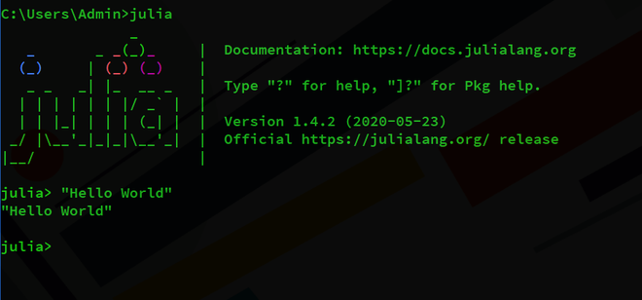
What is natural language?
A structured system of communication used by humans
今天天气真好！
The weather is so nice today!
今日は天気がいいです！
Le temps est vraiment beau aujourd’hui!
Formal Language (e.g., programming languages)
#include <stdio.h>
int main(void) {
printf(“Hello, world!\n”);
}

Slide 5
Natural Language Processing (NLP)
NLP is focused on enabling computers to understand, interpret, and generate human language in a way that is both meaningful and useful.
Teach computers how to understand and generate human languages
Natural Language Understanding
Natural Language Generation
Other names
Computational Linguistics
Natural Language Engineering
Human Language Technology
AI
ML
NLP
DL

Slide 6
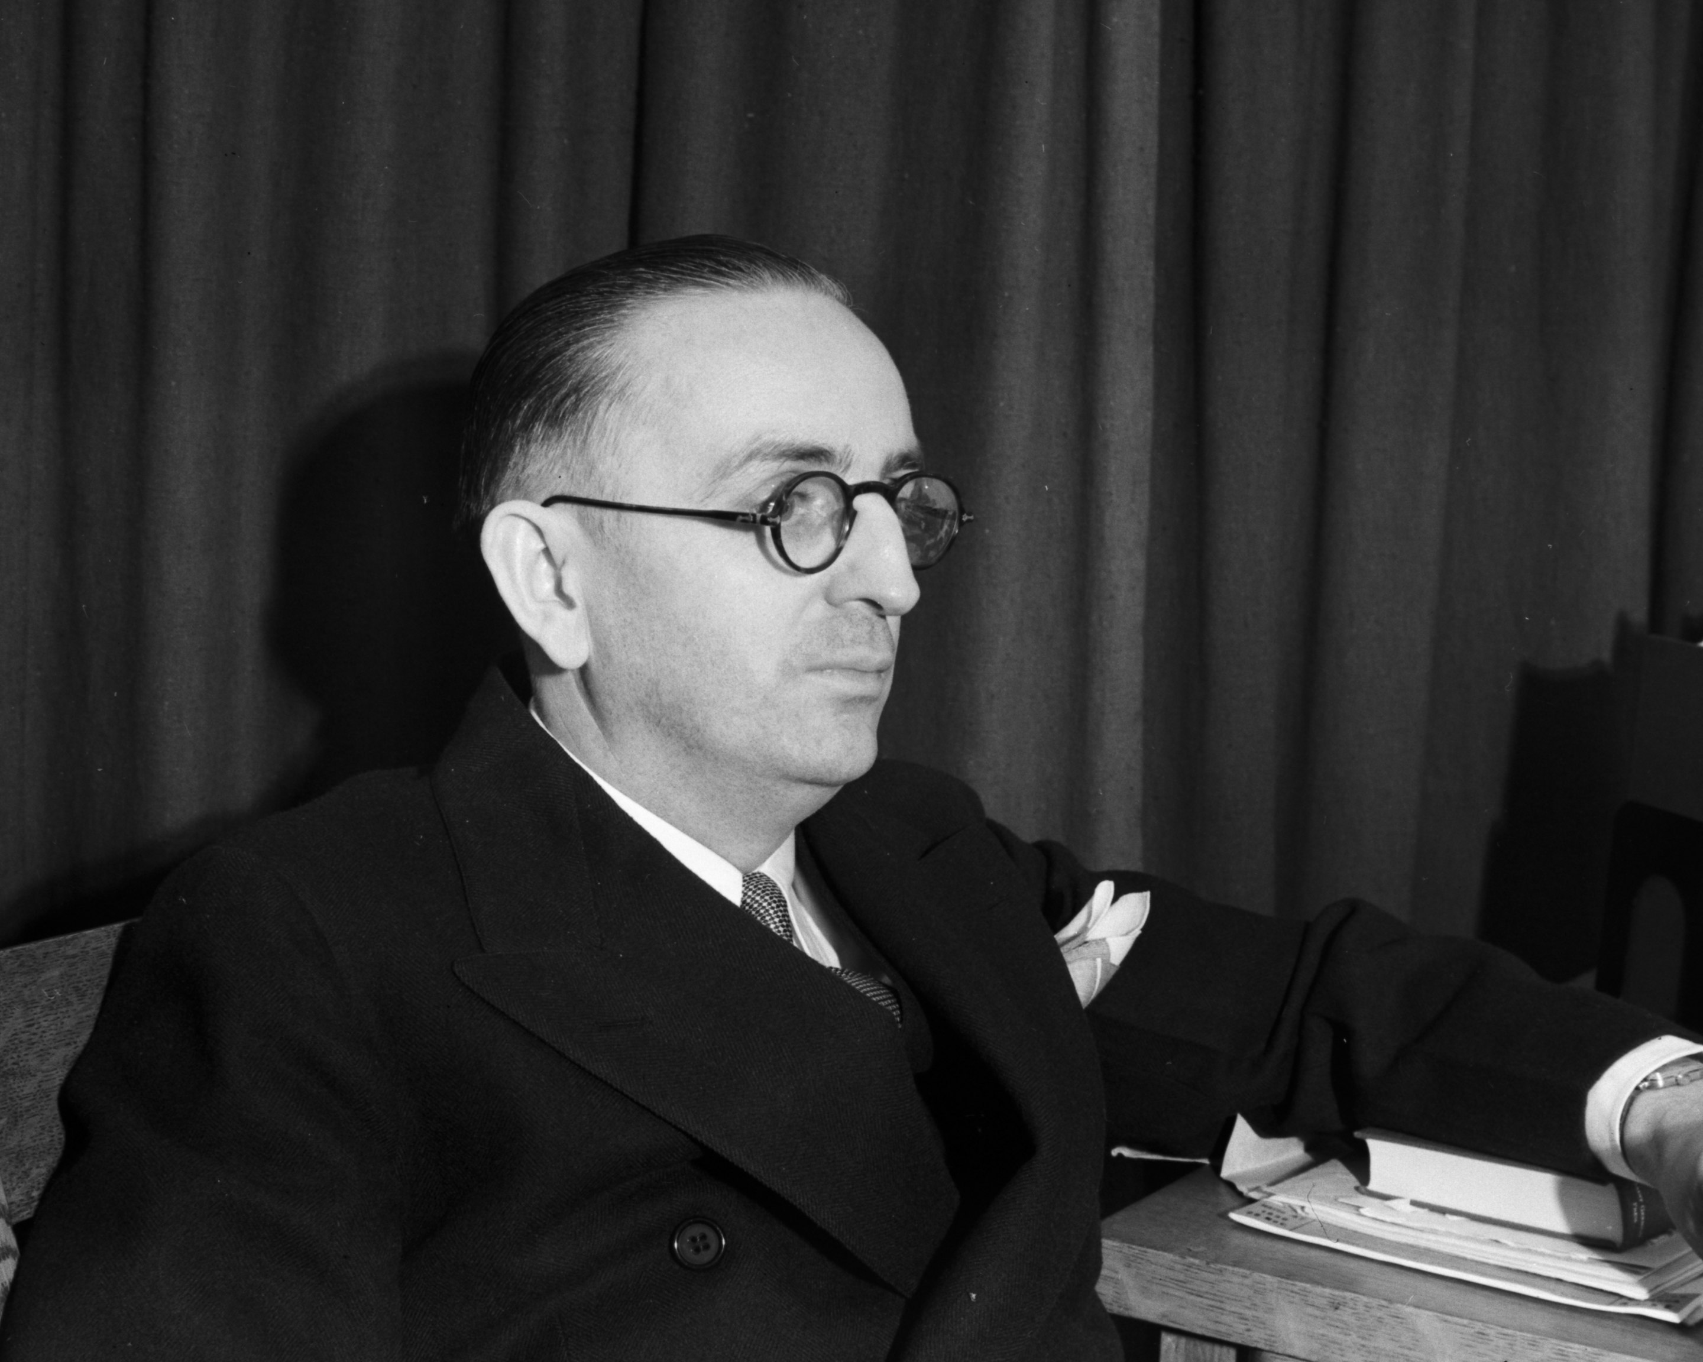

NLP history (1947-1950)
Warren Weaver wrote to Wiener in 1947
One naturally wonders if the problem of translation could conceivably be treated as a problem in cryptography. When I look at an article in Russian, I say: ‘This is really written in English, but it has been coded in some strange symbols. I will now proceed to decode’.
Warren Weaver
1894-1978
Alan Turing wrote “Computing Machinery and Intelligence” in 1950 (proposed the Turing test)
I propose to consider the question, “Can machines think?” This should begin with definitions of the meaning of the terms “machine” and “think.”
Alan Turing, 1912-1954

Slide 7

NLP history - the Turing test
Example of Q&A:
C: Please write me a sonnet on the subject of the Forth Bridge.
A/B: Count me out on this one. I never could write poetry.
C: Add 34,957 to 70,764.
A/B: (Pause about 30 seconds and then give as answer) 105621.
C: Do you play chess?
A/B: Yes.
Hard part: A, the machine, needs to understand the person C and generate human-like languages.

Slide 8
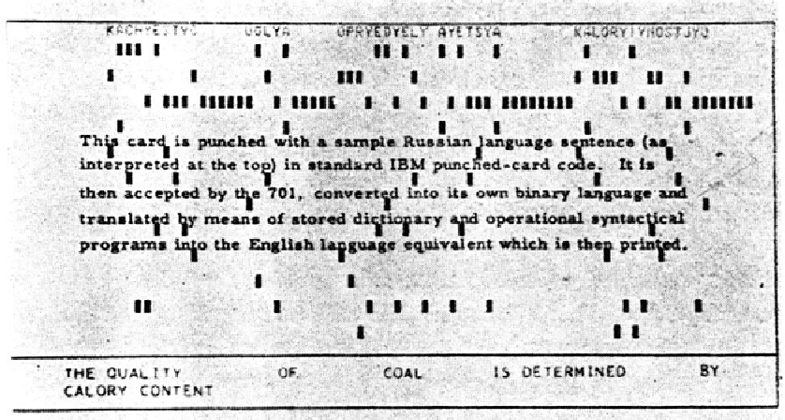
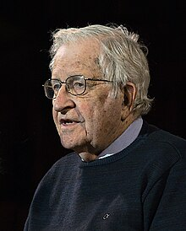

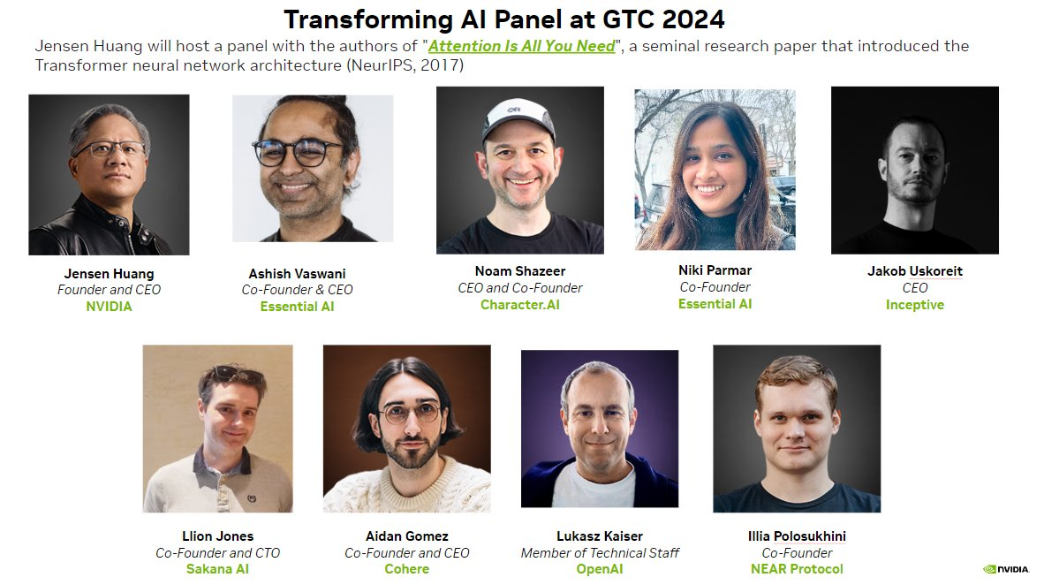

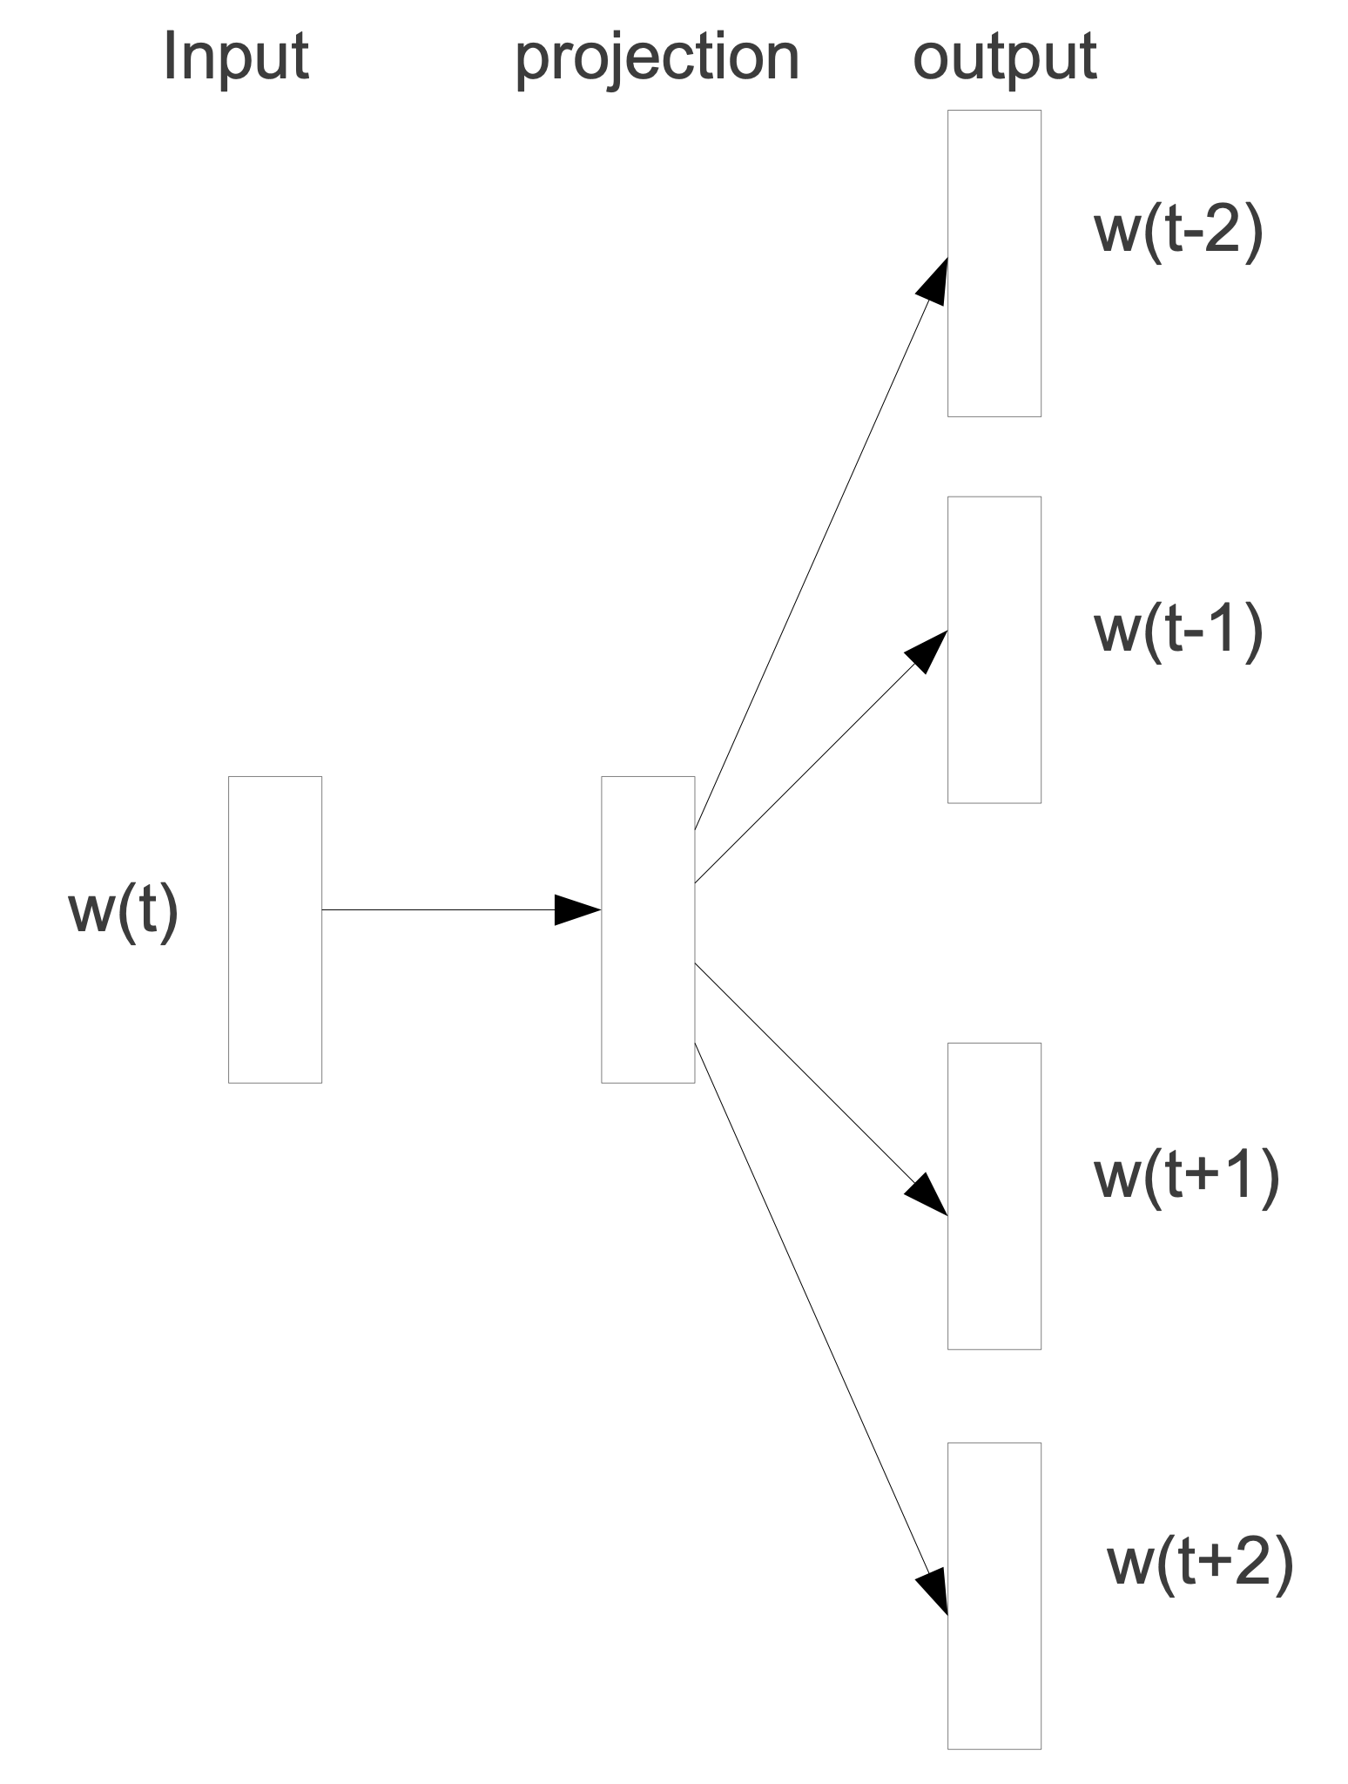

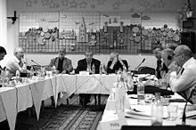
NLP history (1954-2017)
Georgetown–IBM experiment, 1954
Noam Chomsky, 1957
Vladimir Vapnik, 1995
Tomas Mikolov. word2vec, 2013
Attention Is All You Need, 2017

Slide 9
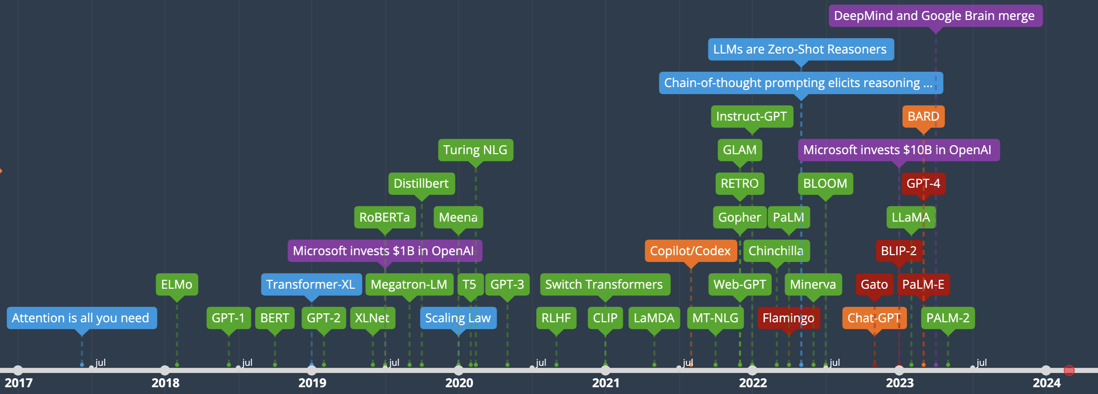
NLP history (2017-Now) - LLMs
Bert, ELMo
GPT-1,2,3
ChatGPT, GPT-4: https://chat.openai.com/
Sora: https://openai.com/sora
By Justin Milner, https://time.graphics/line/815425
https://ai.v-gar.de/ml/transformer/timeline/

Slide 10
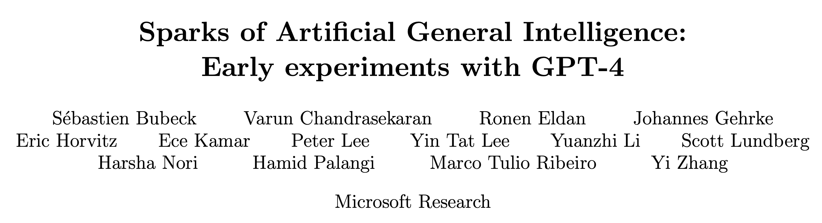

What is next?
Sparks of Artificial General Intelligence (AGI)
https://arxiv.org/abs/2303.12712
Prompt: “Draw a unicorn in TikZ”
Query GPT-4 at roughly equal time intervals while the system was being refined, with the prompt “Draw a unicorn in TikZ”. We can see a clear evolution in the sophistication of GPT-4’s drawings.

Slide 11
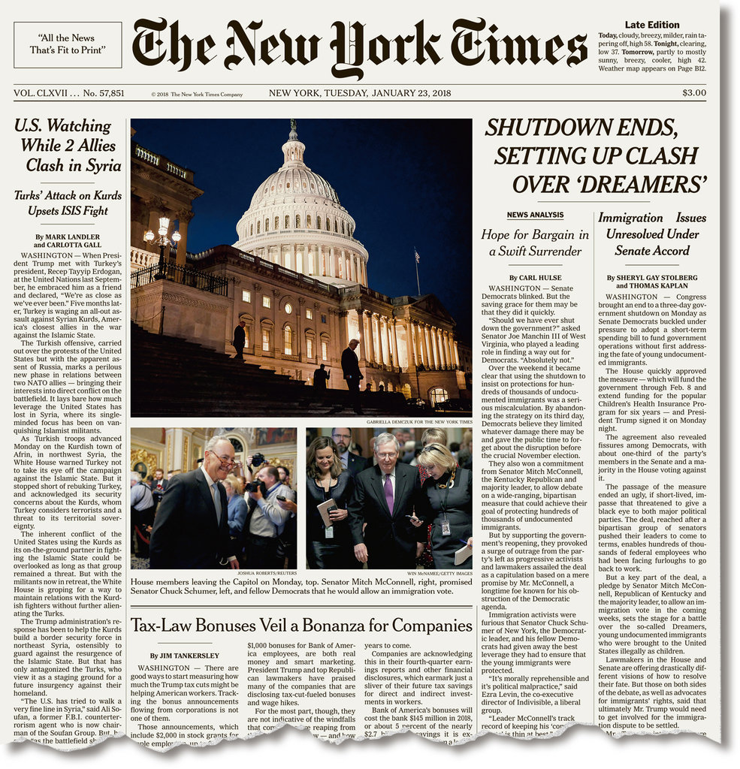
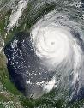



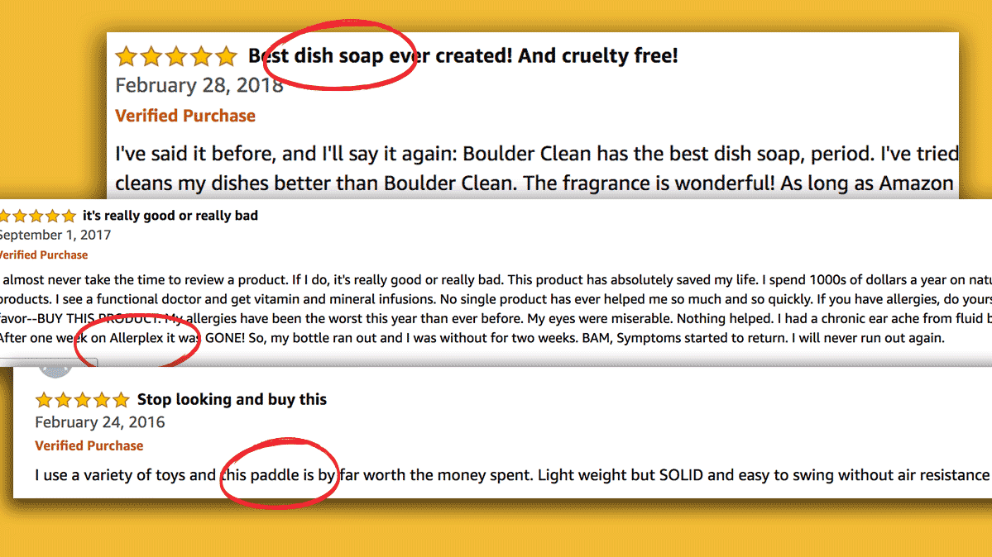
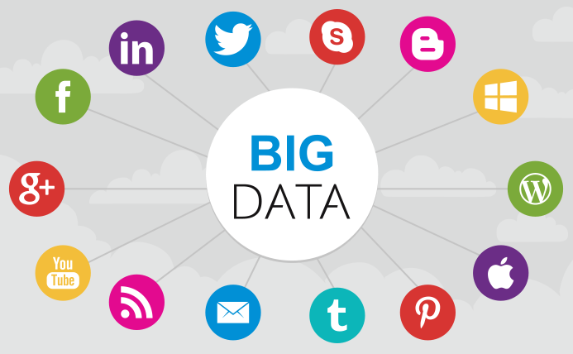

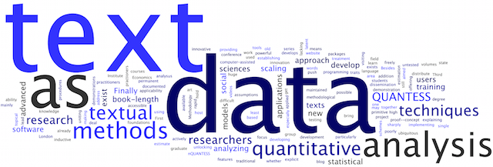

Text data – written text
Topics
People
Events
Products
Sources
Blogs
Microblogs
Forums
Reviews
Books

Slide 12




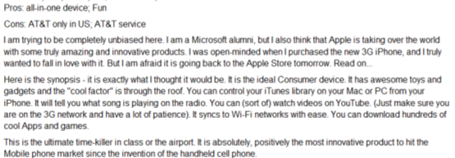

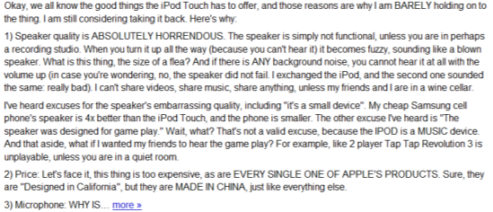
Text data - human as sensors
Sense
Report
Real World
Sensor
Data
Weather
Thermometer
3°C , 15°F
Locations
Geo Sensor
41°N, 120°W
Network Sensor
01000100011100
Networks
Perceive
Express
Human Sensor

Slide 13
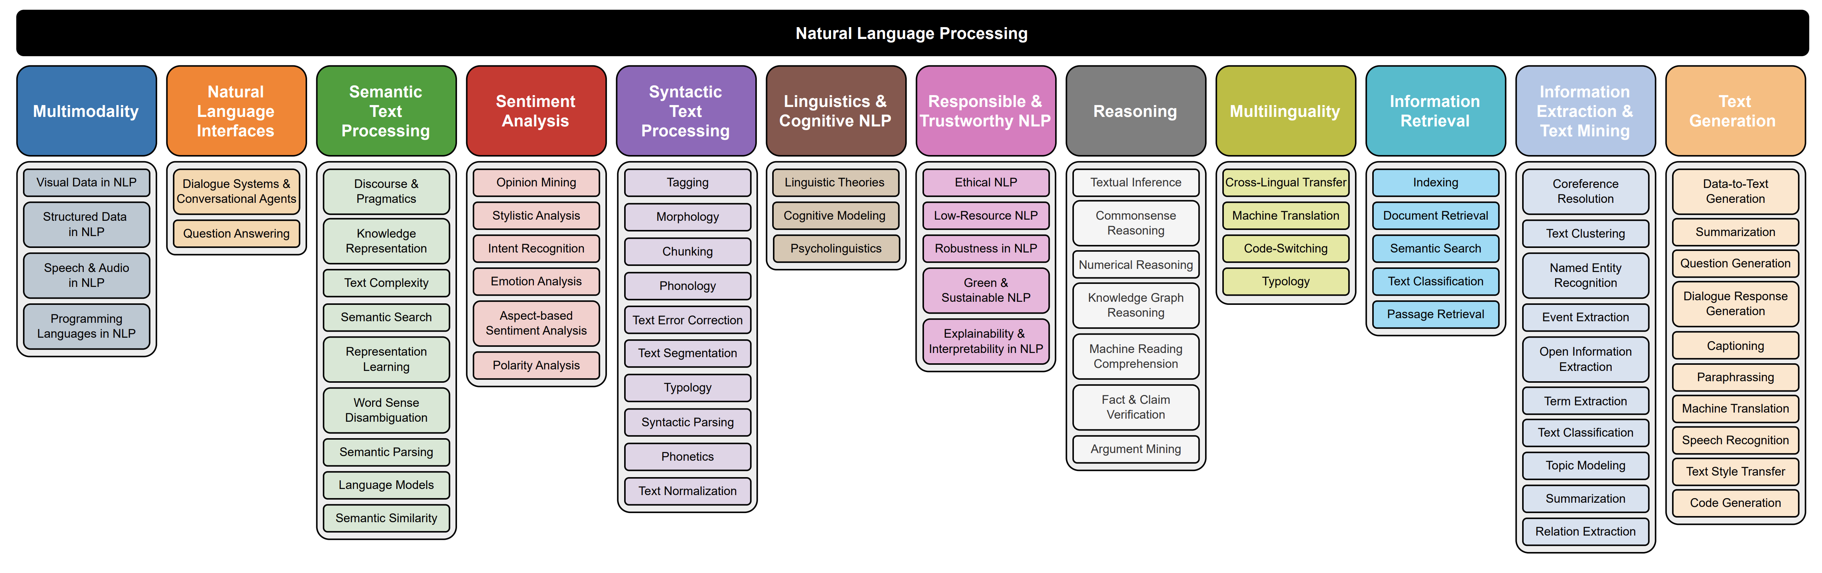
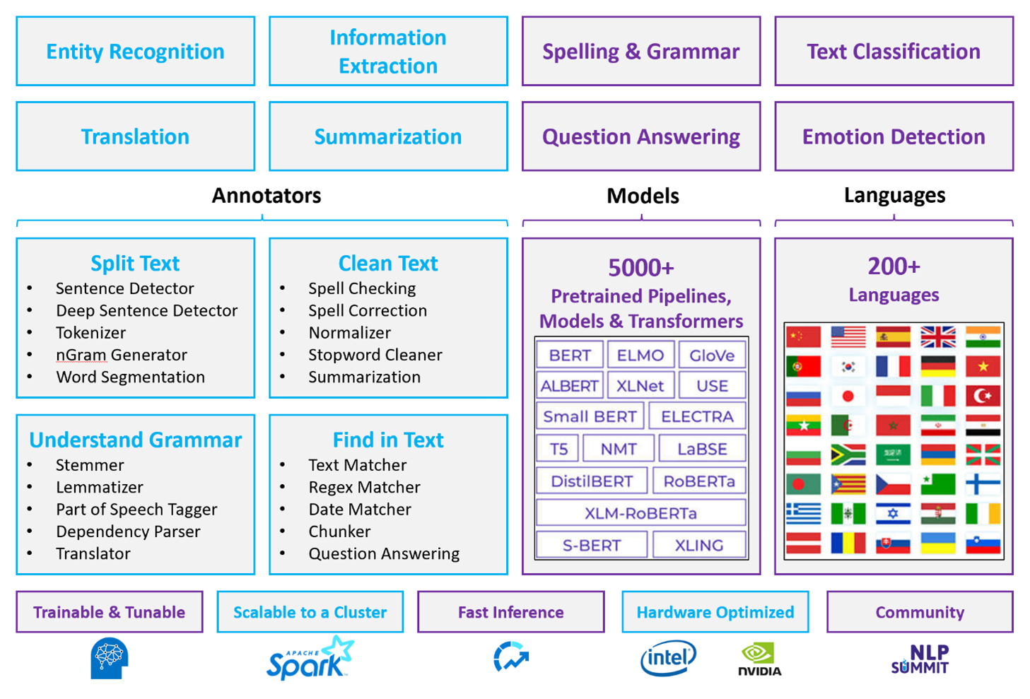
Many NLP tasks
Sentiment analysis
Machine translation
Question and answering
Article generation
Text summarization
Chatbot designing …
https://arxiv.org/abs/2307.10652

Slide 14


Tasks - sentiment analysis
Attributes
Zoom
Affordability
Size and weight
Flash
Ease of use
NLP Model/ Algorithm
Positive
Negative
✓
Nice and compact to carry!
Since the camera is small and light, I won't need to carry around those heavy, bulky professional cameras either!
The camera feels flimsy, is plastic and very light in weight you have to be very delicate in the handling of this camera.
✓
✗

Slide 15
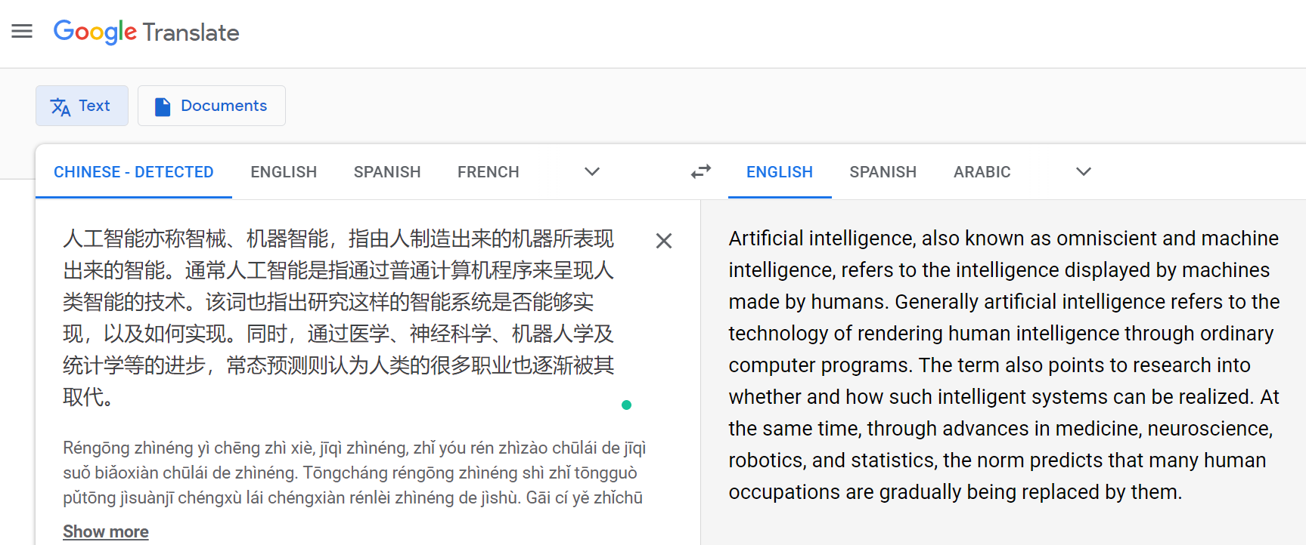
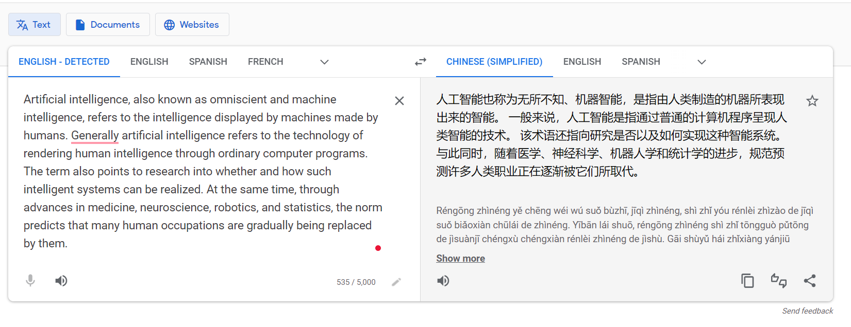
Tasks - machine translation
Chinese → English
English → Chinese

Slide 16
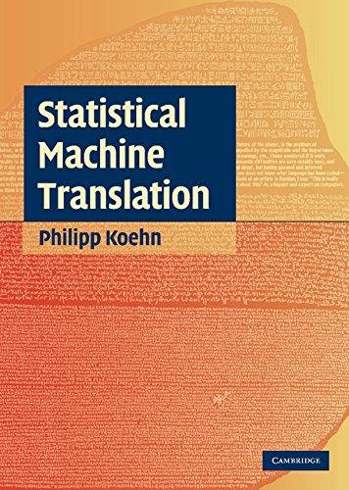
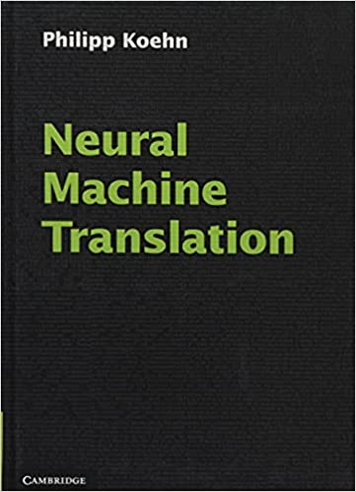
Tasks - machine translation
Warren Weaver on translation as code breaking (1947):
When I look at an article in Russian, I say: “This is really written in English, but it has been coded in some strange symbols. I will now proceed to decode”
Machine translation research started in the 1960s.
Statistical machine translation
Neural machine translation
?
1960
1990 – 2000
2015
Future

Slide 17
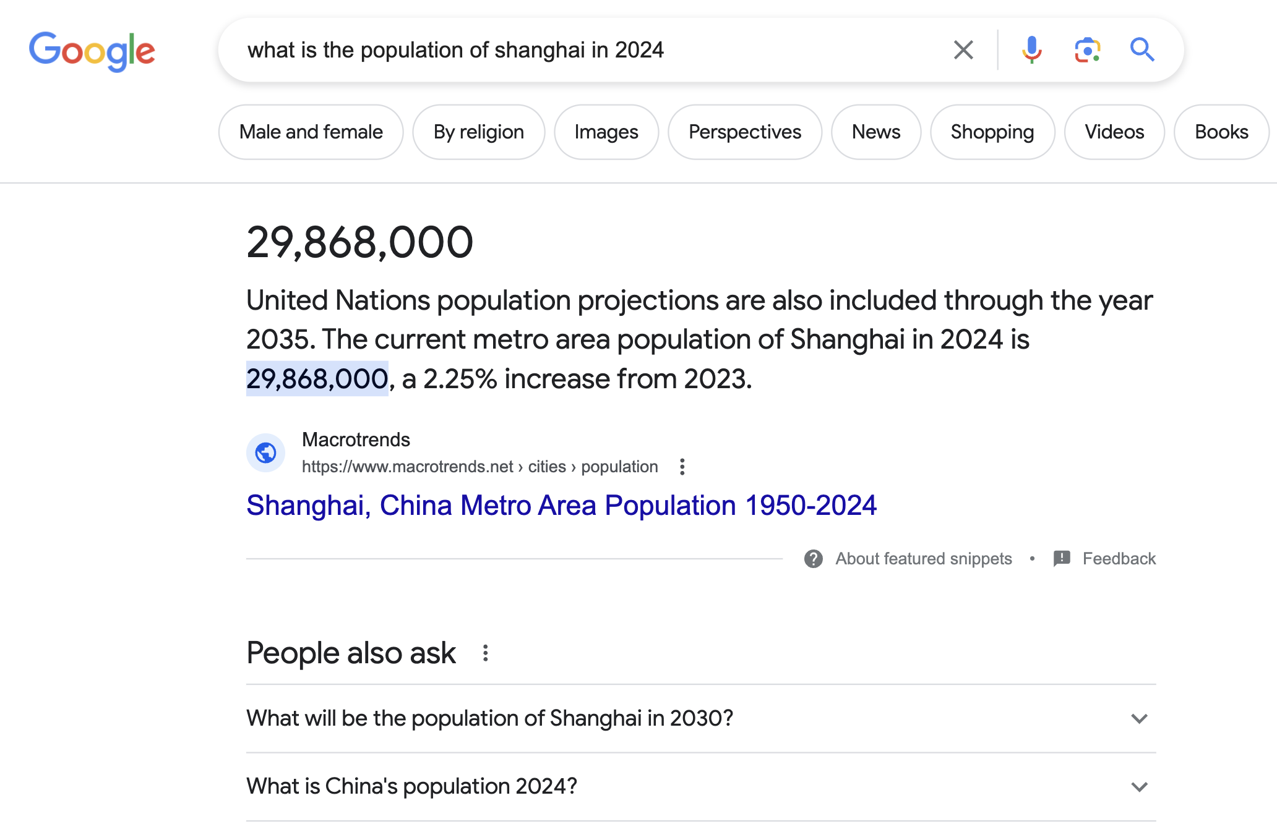
Tasks - question and answering (QA)
QA provides answers to question directly
Advance version of information retrieval

Slide 18
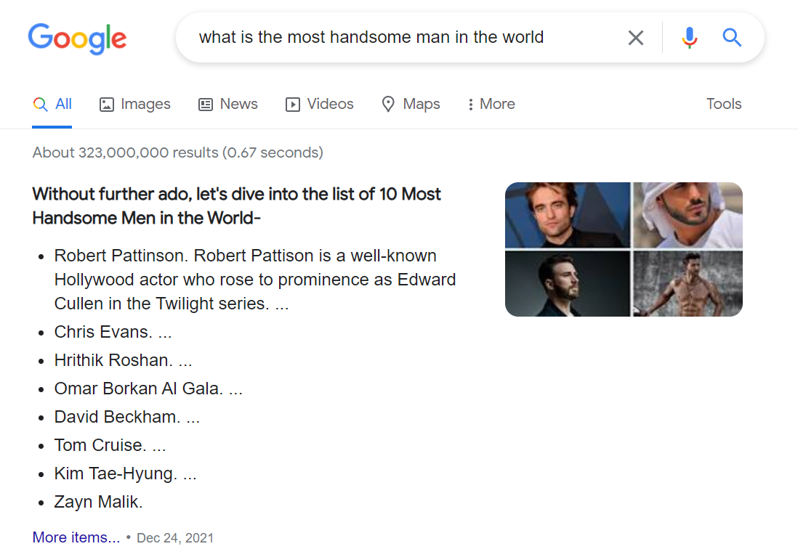
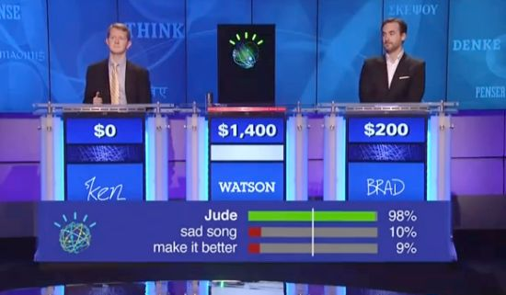
Tasks - QA
The DeepQA computer won TV’s smartest quiz show and kicked off an era of natural language processing.
In a televised Jeopardy, contest viewed by millions in February 2011, IBM’s Watson DeepQA computer made history by defeating the TV quiz show’s two foremost all-time champions, Brad Rutter and Ken Jennings.

Slide 19
Tasks – article generation
A: Blog
Title: Feeling unproductive? Maybe you should stop overthinking.
Content: In order to get something done, maybe we need to think less. Seems counter-intuitive, but I believe sometimes our thoughts can get in the way of the creative process. We can work better at times when we "tune out" the external world and focus on what's in front of us. I've been thinking about this lately, so I thought it would be good to write an article about it…
B: News article
Title: United Methodists Agree to Historic Split
Content: After two days of intense debate, the United Methodist Church has agreed to a historic split - one that is expected to end in the creation of a new denomination, one that will be “theologically and socially conservative,” according to The Washington Post. The majority of delegates attending the church‘s annual General Conference in May voted to strengthen a ban on the ordination of LGBTQ clergy and to write new rules that will “discipline” clergy who officiate at same-sex weddings. But those who opposed these measures have a new plan…
A: Human Written B: Human Written
A: Machine Written B: Human Written
A: Human Written B: Machine Written
A: Machine Written B: Machine Written
They are all generated by GPT-3!

Slide 20
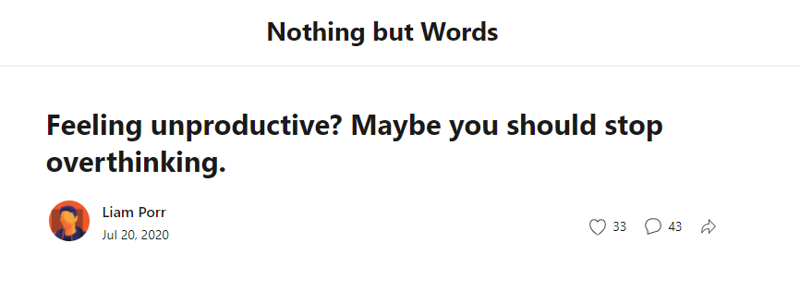
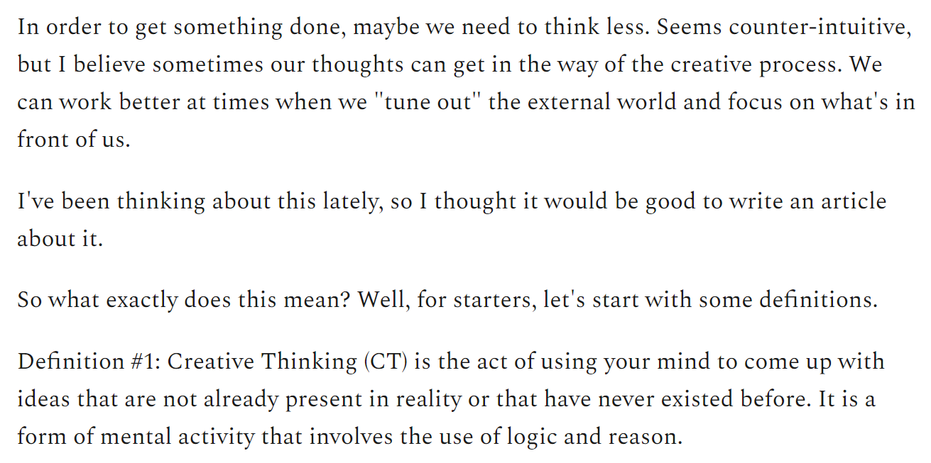
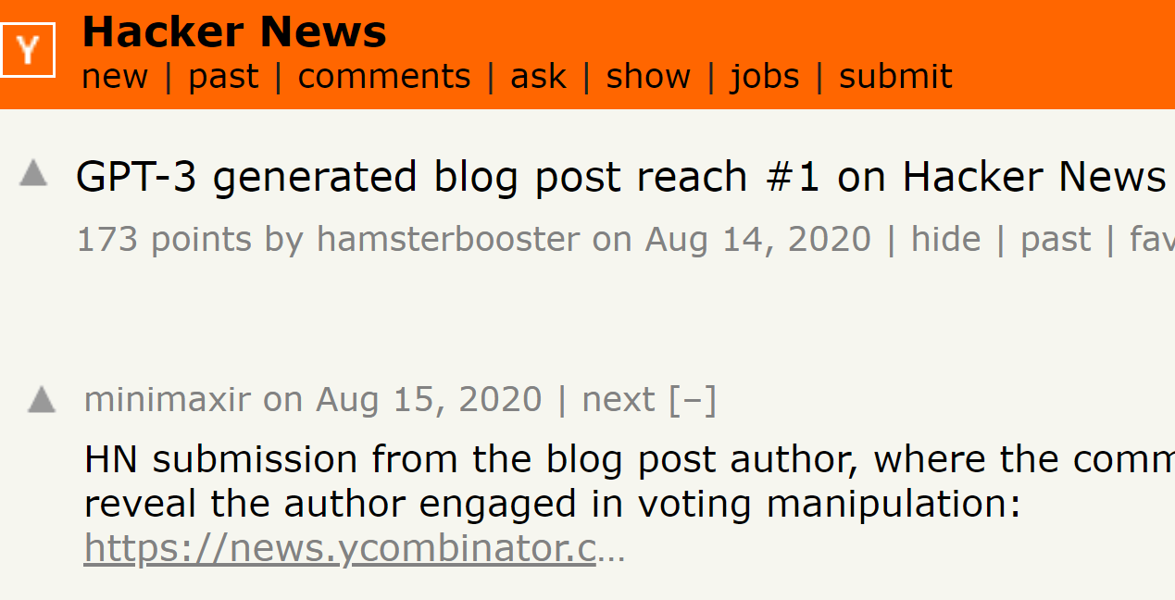
Tasks – article generation
GPT-3 generated blogs

Slide 21
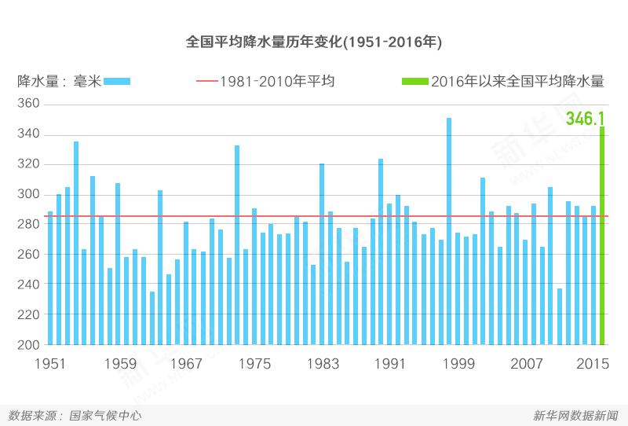
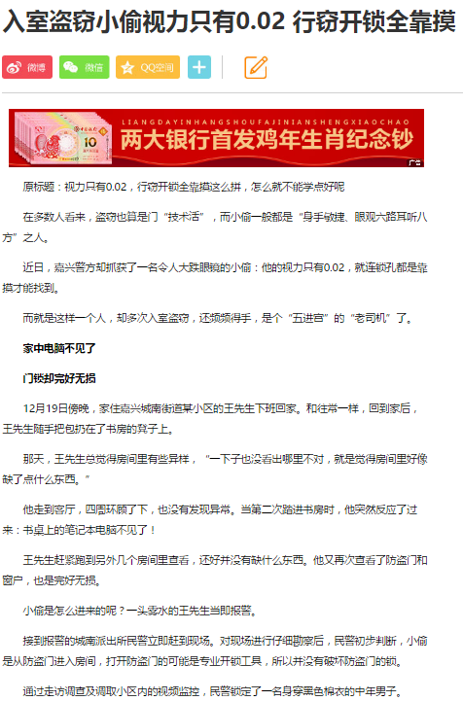
Tasks – text summarization
Summarization
User Comment
News Re-writing
从1981年到2010年，全国平均降水量为280毫米 …
News
Comment
Conversation

Slide 22

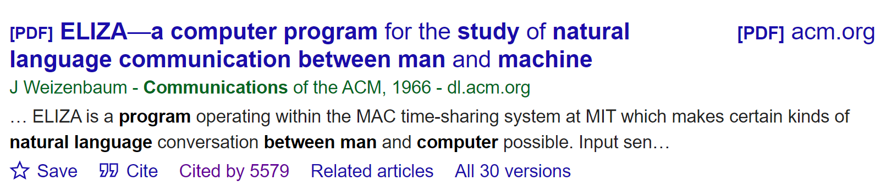
Applications - Chatbot
A: Men are all alike
B: In what way?
A: They're always bugging us about something or other.
B: Can you think of a specific example?
A: Well, my boyfriend made me come here.
B: Your boyfriend made you come here?
A: He says I'm depressed much of the time.
B: I’m sorry to hear you are depressed.
A: It’s true. I am unhappy.
B: Do you think coming here will help you not to be unhappy?
A: I need some help, that much seems certain.…
A: Human B: Human
A: Machine B: Human
A: Human B: Machine
A: Machine B: Machine
A: Human B: Machine

Slide 23
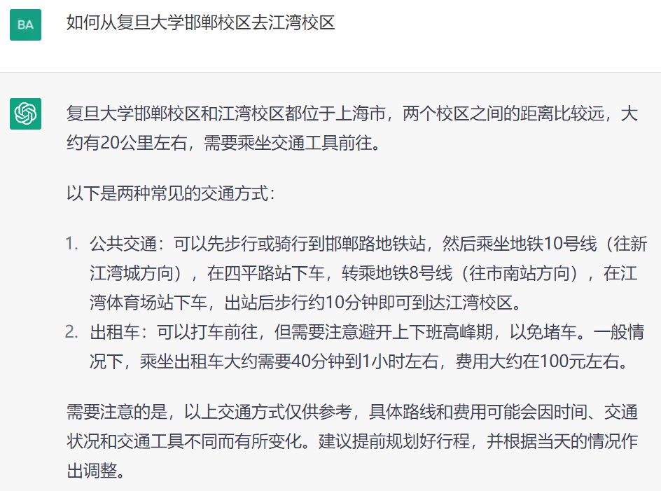
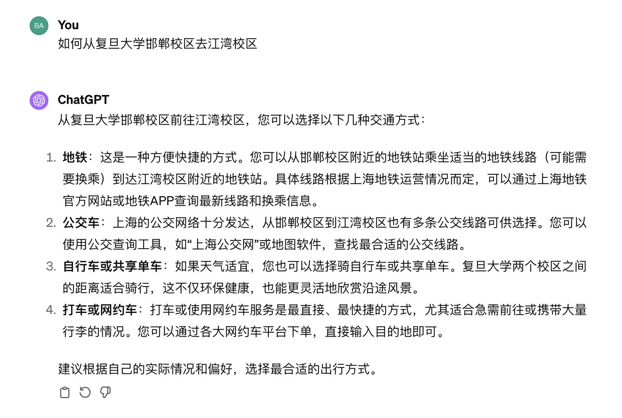
Applications - Chatbot (ChatGPT)
2023-2
2024-2
Please register an account, if you do not have one.

Slide 24

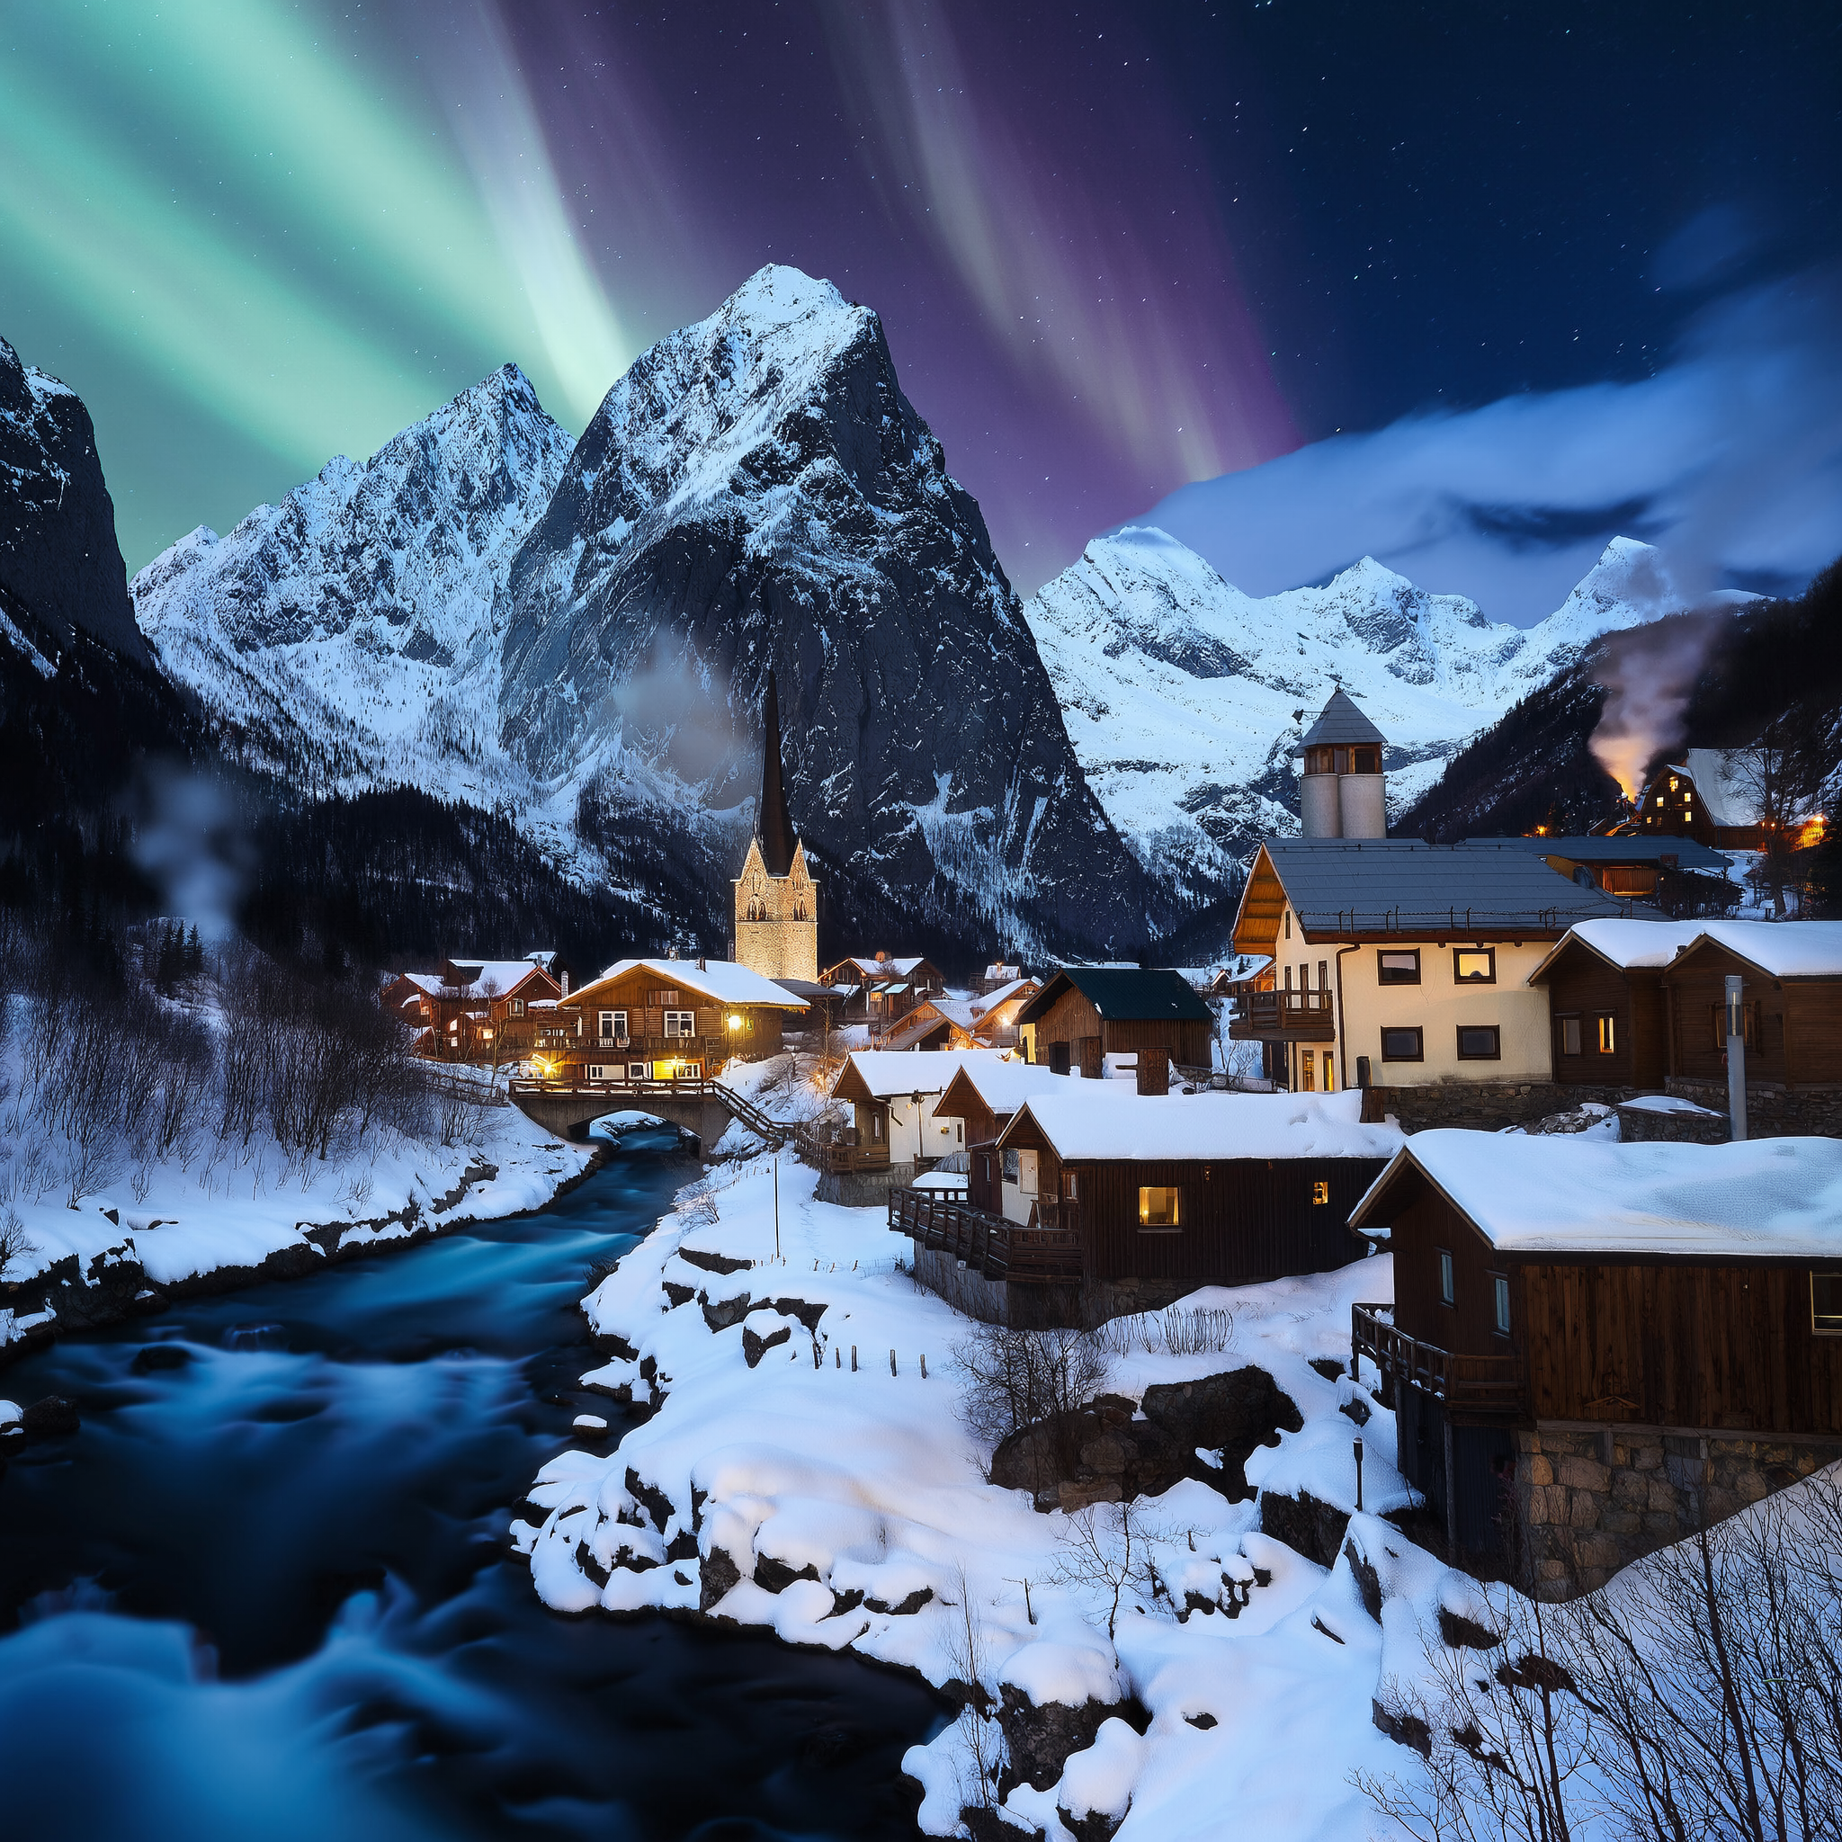

Applications – text to image (OpenAI, Sora)
Creating image from text
Vibrant coral reef teeming with colorful fish and sea creatures
A snowy mountain village with cozy cabins and a northern lights display, high detail and photorealistic dslr, 50mm f/1.2
Close-up portrait shot of a woman in autumn, extreme detail, shallow depth of field

Slide 25

Applications – text to video (OpenAI, Sora)
Creating video from text: a woman wearing purple overalls and cowboy boots taking a pleasant stroll in Johannesburg South Africa during a beautiful sunset

Slide 26
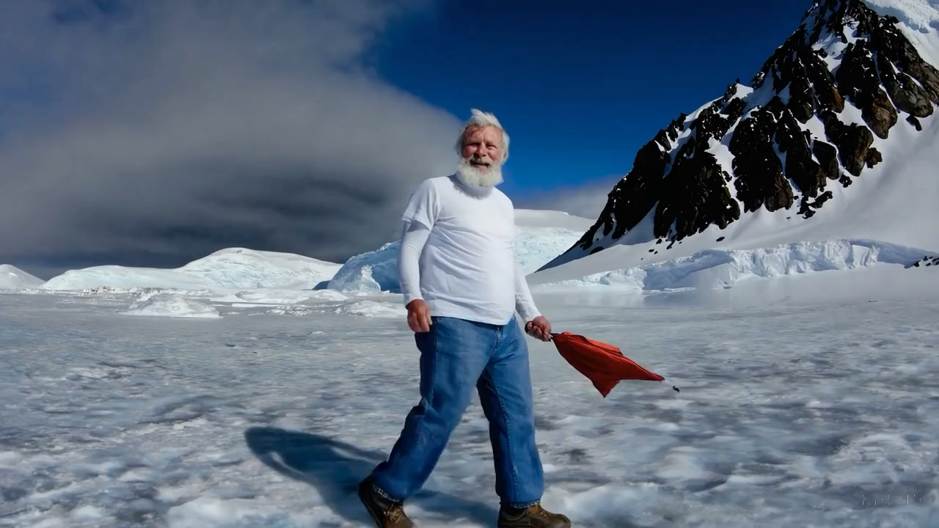
Applications – text to video (OpenAI, Sora)
Creating video from text: an old man wearing blue jeans and a white T-shirt taking a pleasant stroll in Antarctica during a winter storm

Slide 27


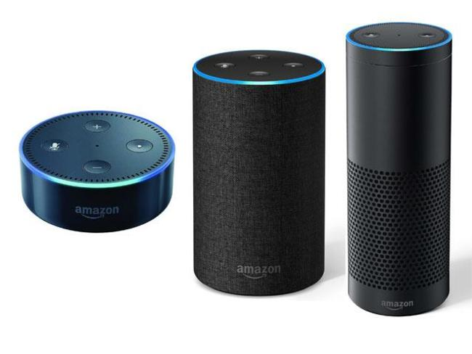

Many other tasks and products

Slide 28
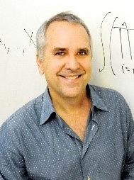
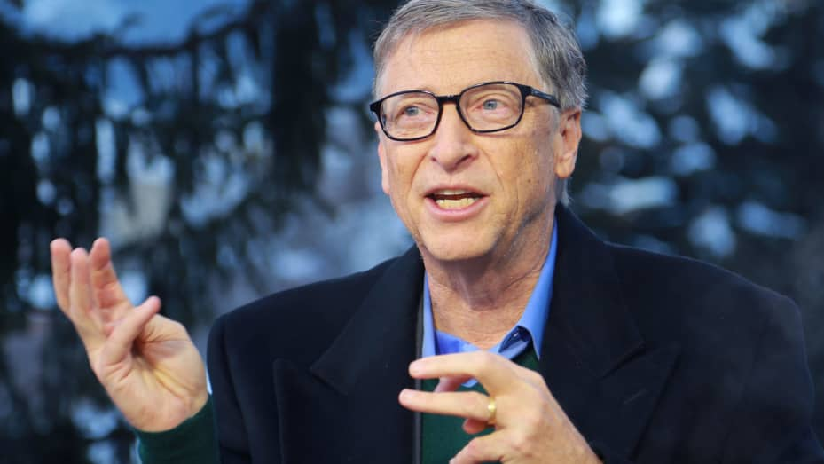
NLP is the future!
Predicted before LLMs era:
If I have 1 Billion dollars, I will build a research team focusing on Natural Language Processing
If I were starting a company today, it would use AI to teach computers how to read.

Slide 29

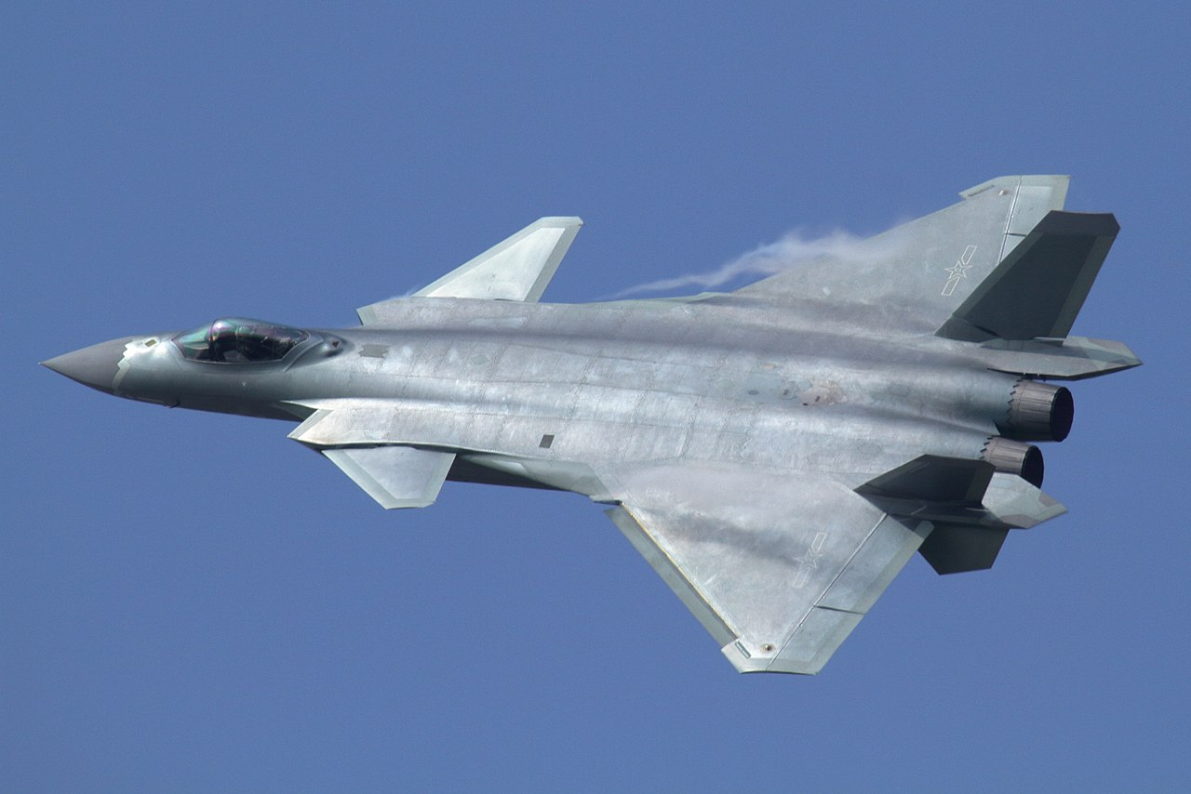

NLP is difficult!
Ambiguity makes NLP hard!
A man saw a boy with a telescope. - Who had the telescope?
He has quit smoking. – It means that he smoked before.
What does the Mighty Dragon mean？

Slide 30
Ambiguities in English
Teacher strikes idle kids.
The chickens are too hot to eat.
The old men and women left the room.
He left her in tears.
Hospitals are sued by 6 foot doctors.

Slide 31
Ambiguities in Chinese
冬天，能穿多少穿多少；夏天，能穿多少穿多少；
剩女的原因：一是谁都看不上，二是谁都看不上；
单身的来由：原来是喜欢一个人，现在是喜欢一个人；
女致电男友：地铁站见。如果你到了我还没到，你就等着吧。如果我到了你还没到，你就等着吧！

Slide 32
Hard to inference
Example:
A dime is better than a nickel
A nickel is better than a penny
Therefore, a dime is better than a penny
Adversarial Example:
A penny is better than nothing
Nothing is better than world peace.
Therefore, a penny is better than world peace ???

Slide 33


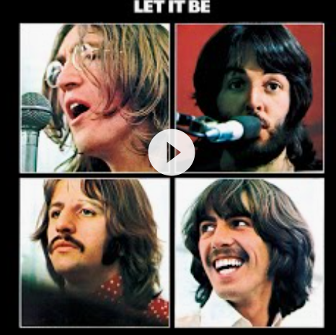
Other difficulties
Non-standard English
Segmentation issues
Idioms
Great job @justinbieber! Were SOO PROUD of what youve accomplished! U taught us 2 #neversaynever & you yourself should never give up either♥
dark horse
lose face
break a leg
bite the bullet
San Francisco
Los Angeles
the New York-New Haven Railroad
the New York-New Haven Railroad
Neologisms
World knowledge
Tricky entity names
unfriend
Retweet
bromance
鸡娃
Where is A Bug’s Life playing …
Let It Be was recorded …
Mary and Sue are sisters.
Mary and Sue are mothers.

Slide 34
NLP conferences and related
Natural Language Processing
ACL, EMNLP, COLING, NAACL, EACL (https://aclanthology.org/ )
Machine learning
ICML, NIPS, ICLR
Information Retrieval
SIGIR, WWW, CIKM, WSDM
Data Mining
KDD

Slide 35
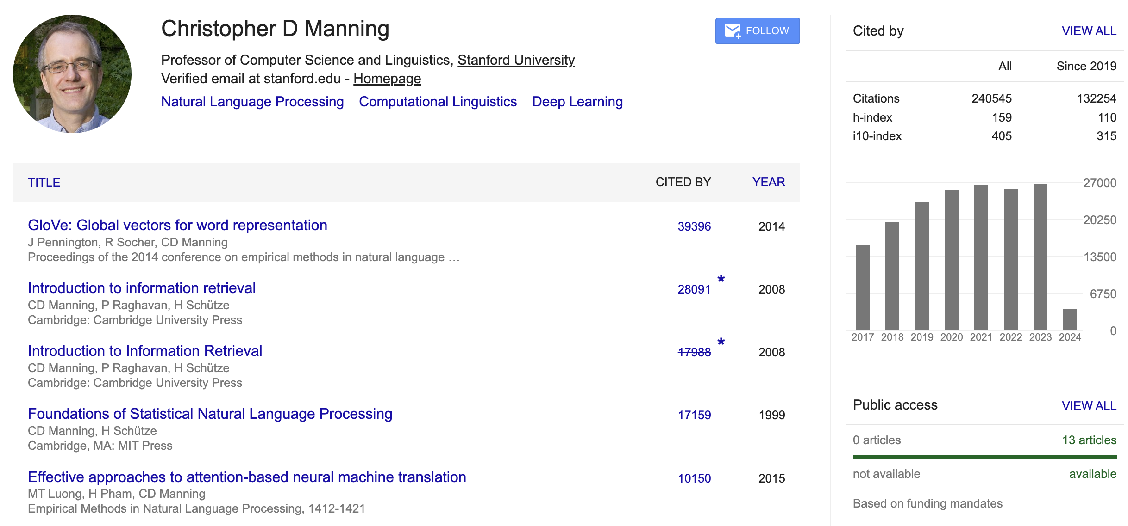
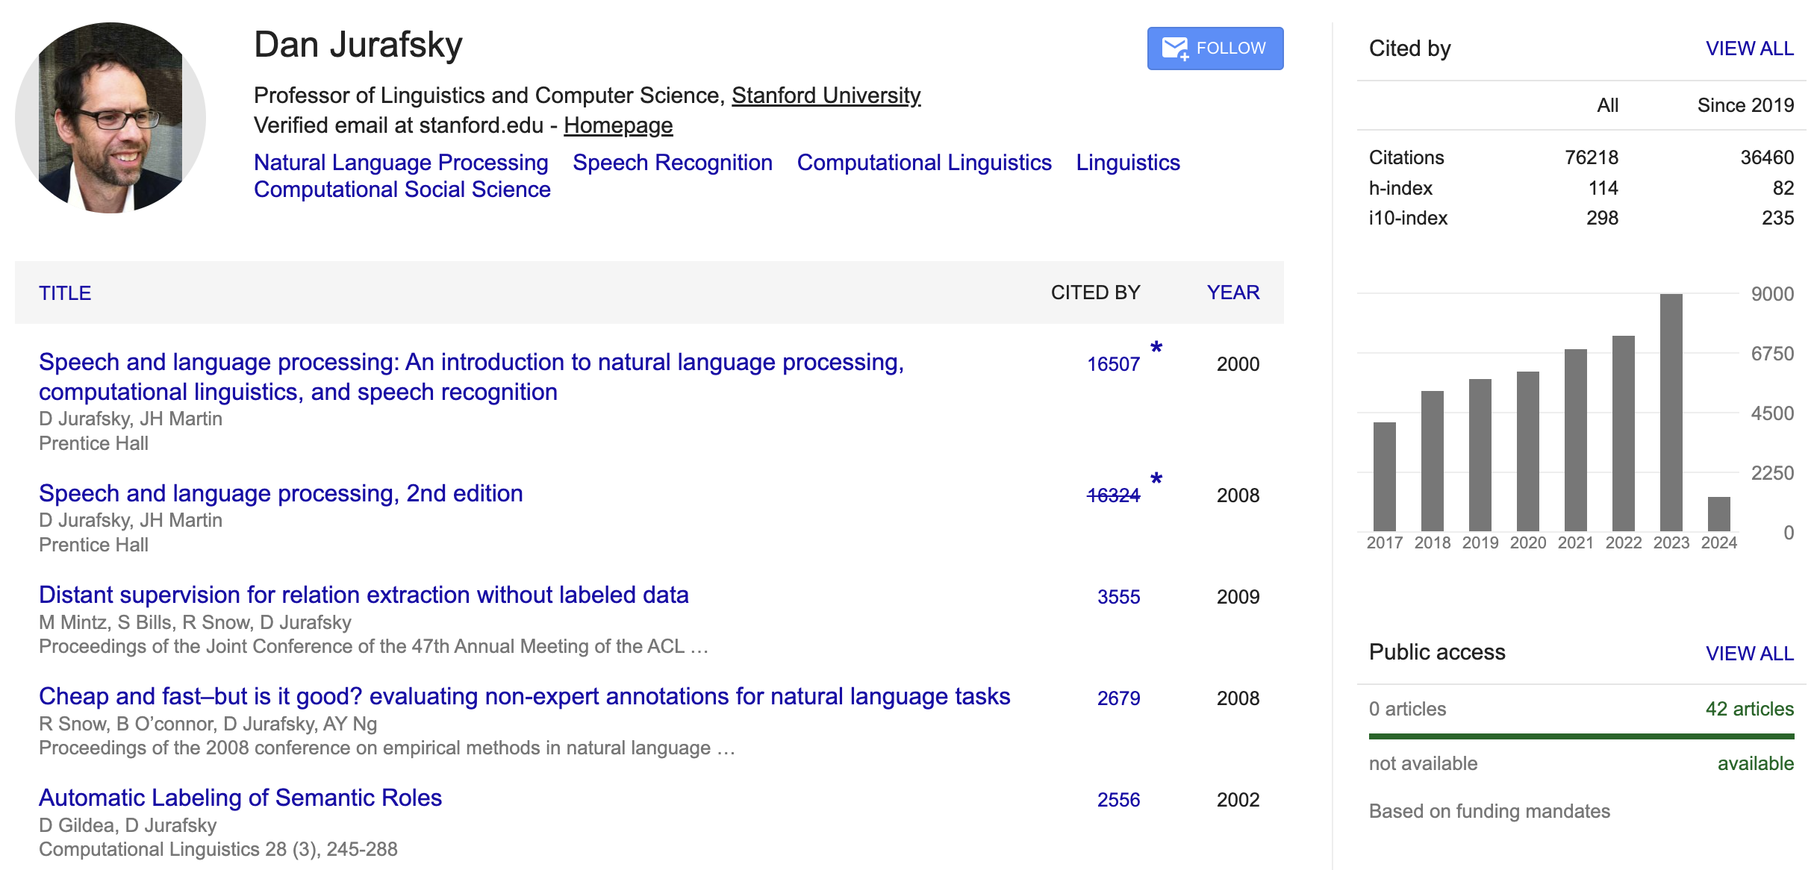
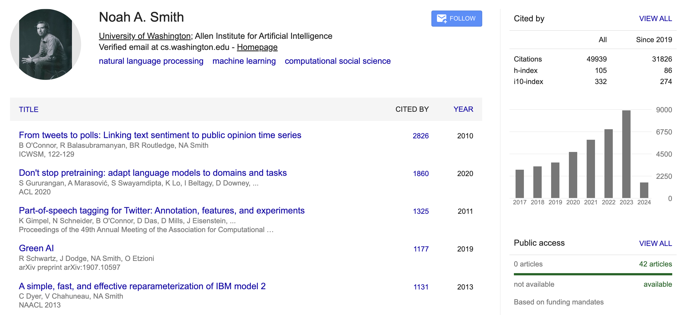
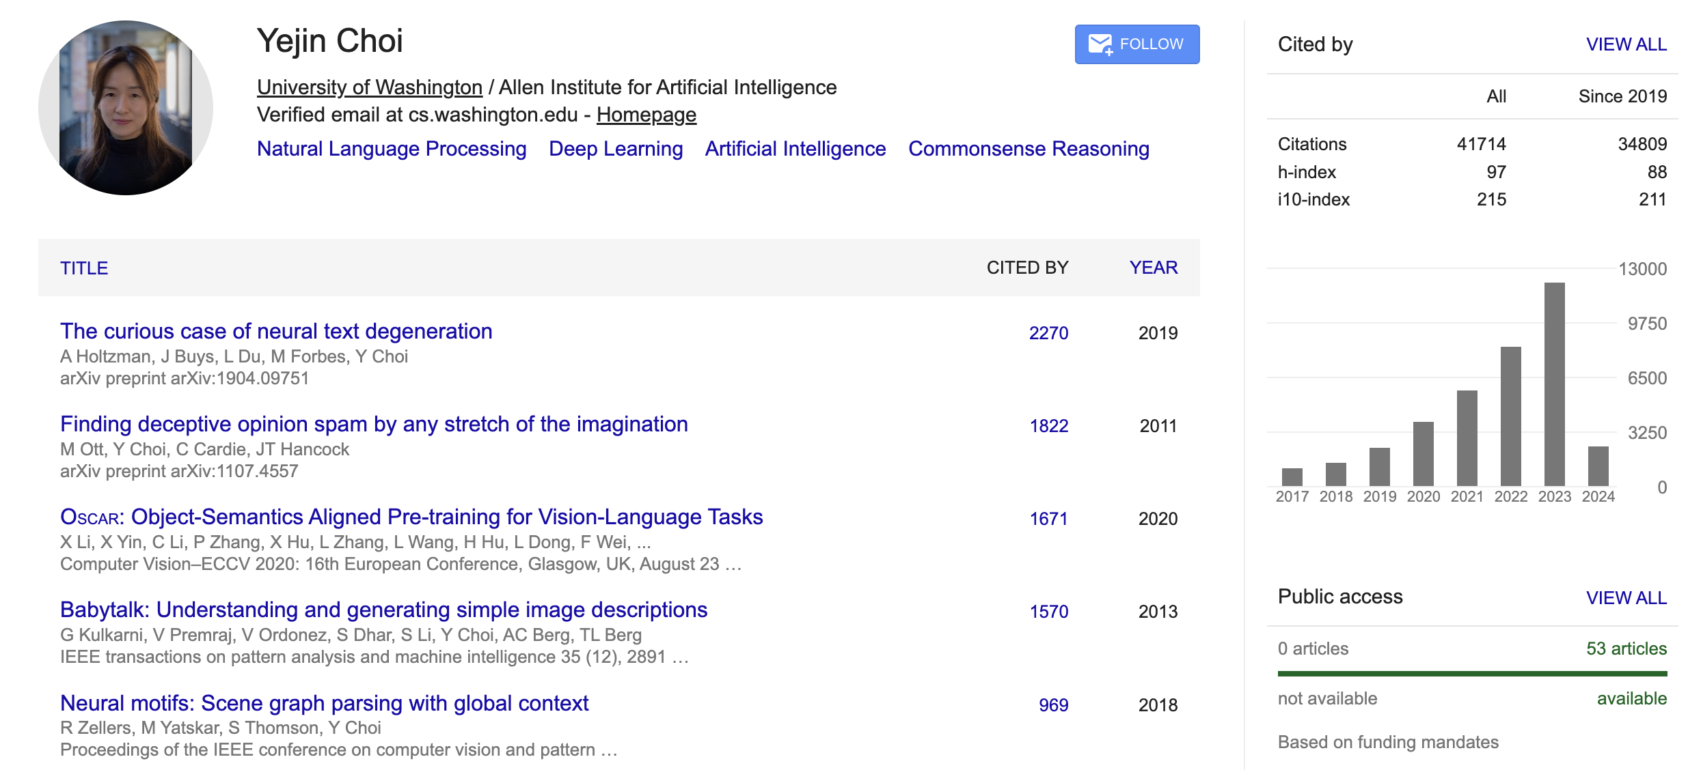
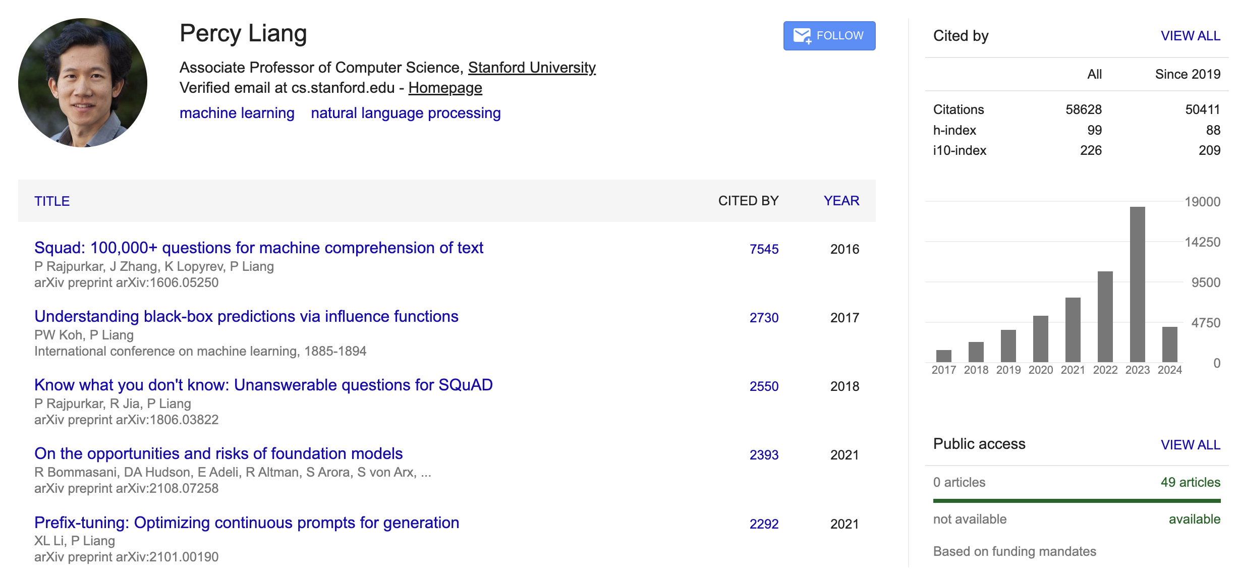
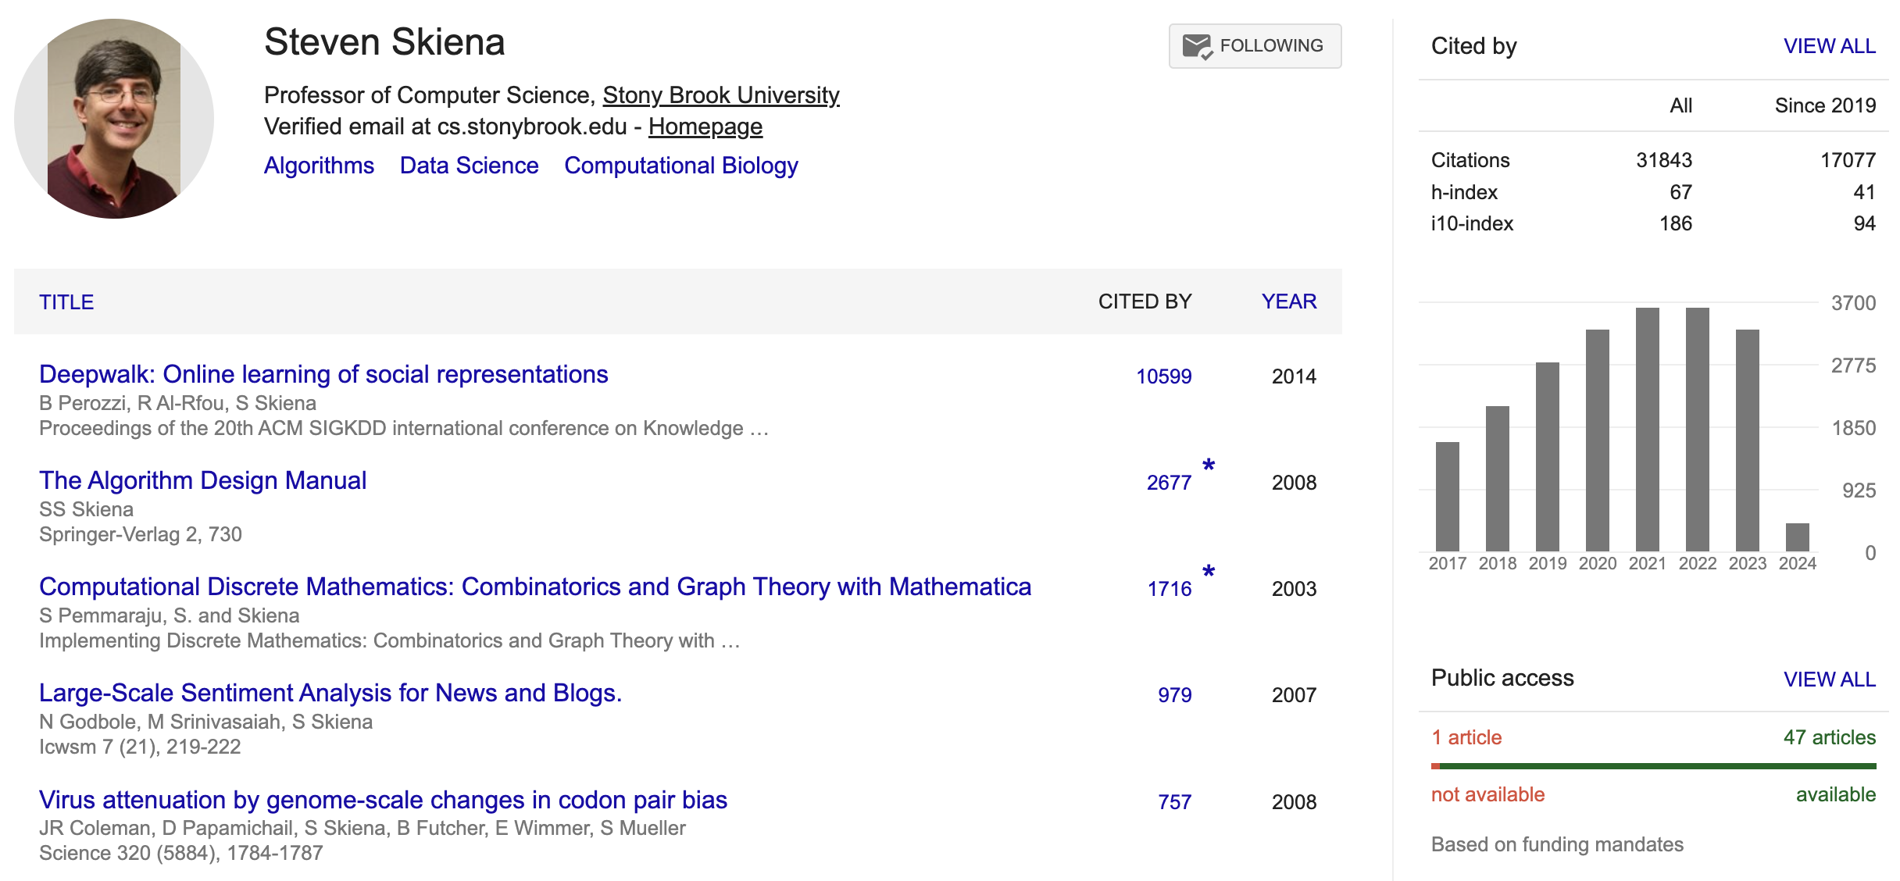
People in NLP

Slide 36
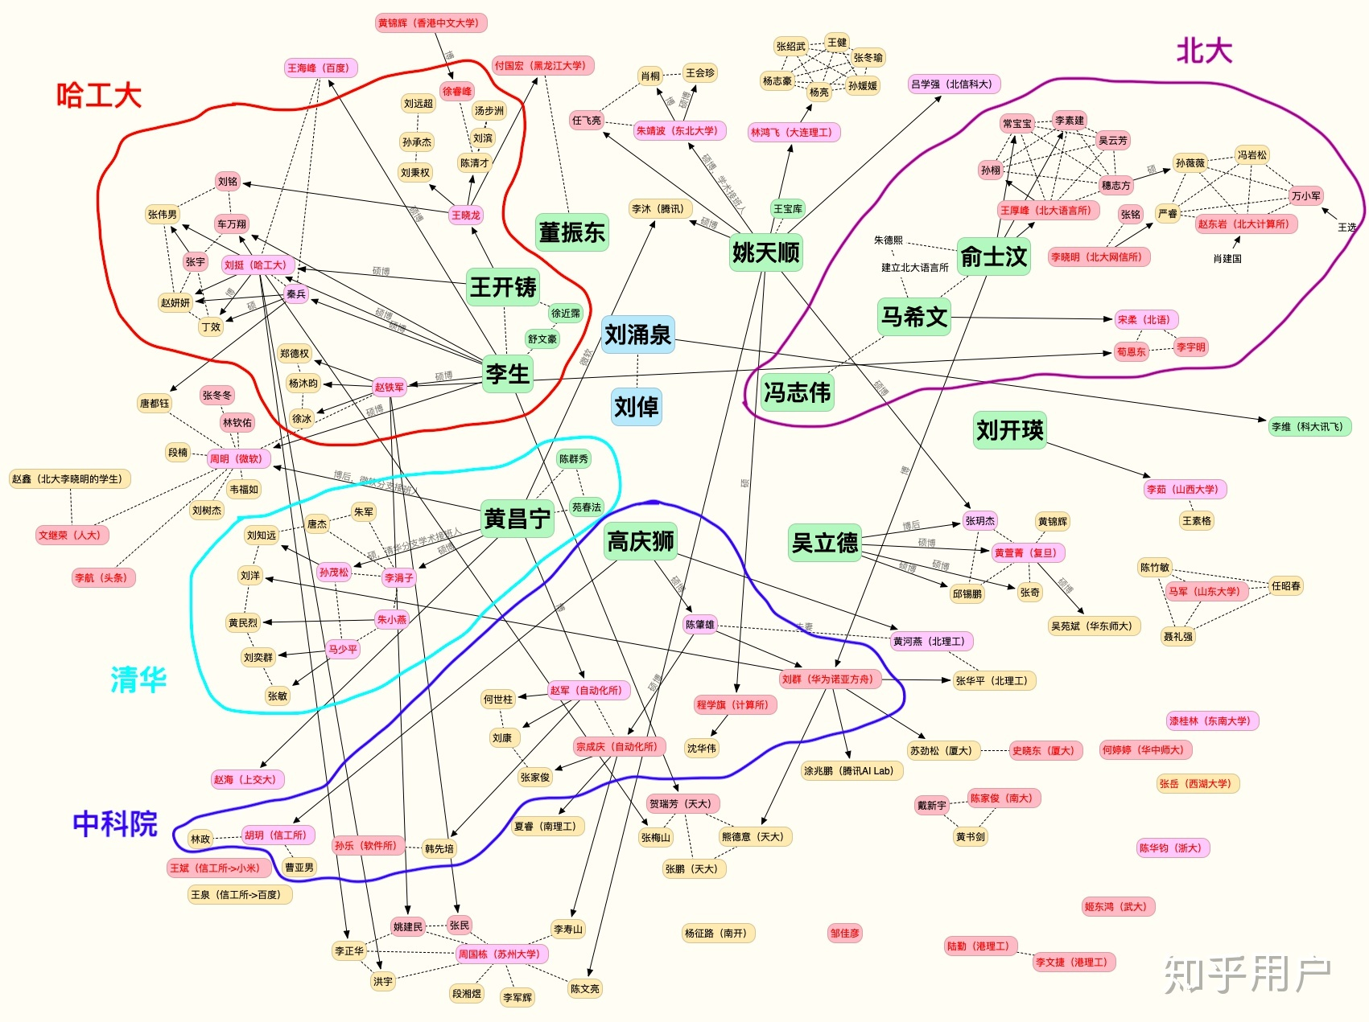
People in NLP (China)
知乎:
https://www.zhihu.com/question/24366306

Slide 37
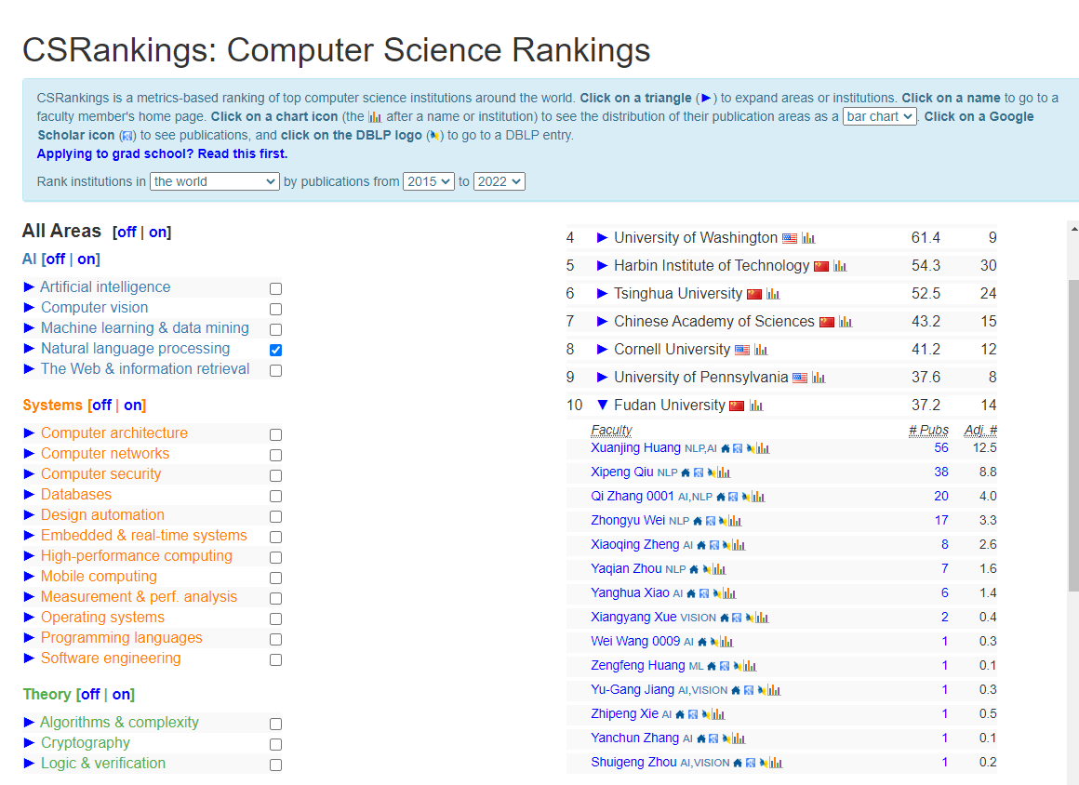
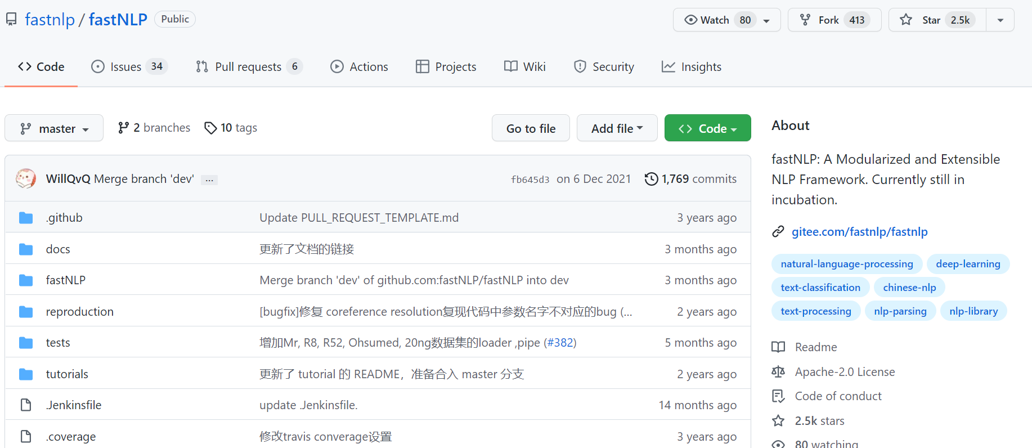
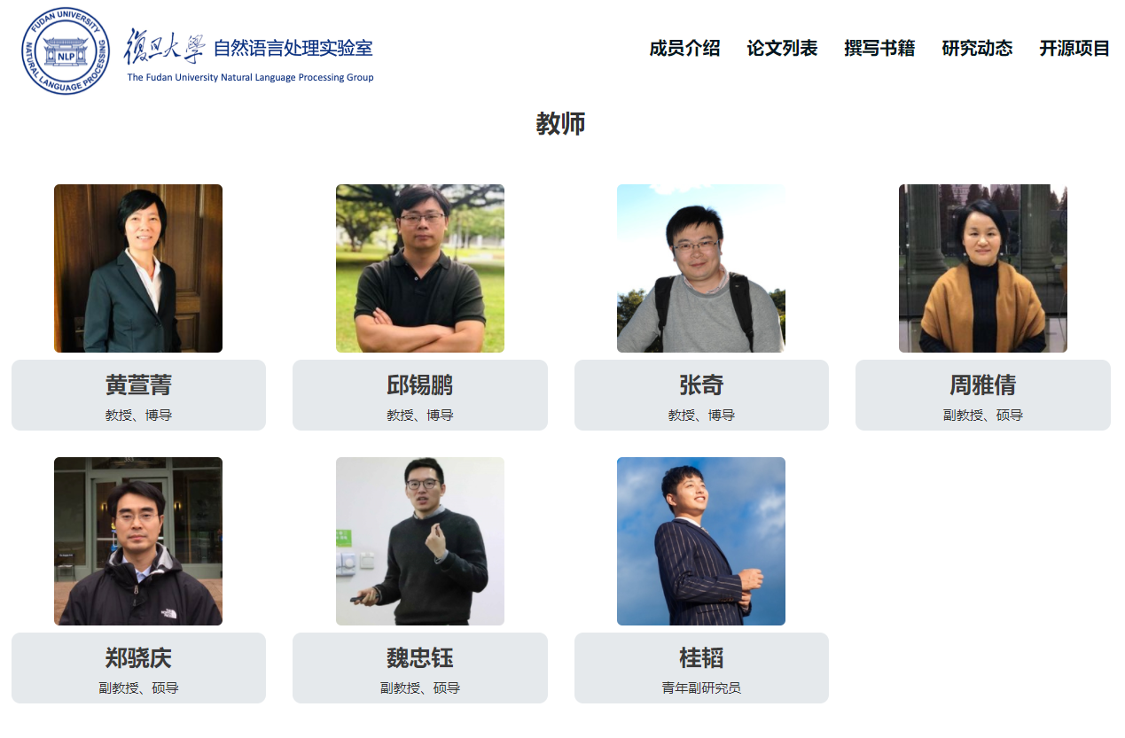
People in NLP (Fudan)
邱锡鹏老师的回答：
https://www.zhihu.com/question/24366306/answer/123787923

Slide 38
Research Labs
https://openai.com/research/ (Microsoft)
https://ai.googleblog.com/
https://deepmind.com/
https://ai.tencent.com/ailab/nlp/en/index.html
Facebook, Amazon, Baidu, Huawei
Many others
Notes:
-------------------------------------------------------------------------------------

Slide 39
Skills needed
Linear algebra (vectors, matrices)
Basic Statistics/ Machine Learning algorithms
Basic Python programming skills
Communication skills (team project)
Notes:
-------------------------------------------------------------------------------------

Slide 40

What we will cover?
(Basics) Text pre-processing and tokenization
(Basics) Language models ($N$-grams)
(Basics) Naïve Bayes and text classification
(Basics) Logistic regression and learning LR
(Basics) Word embeddings (word2vec)
(Basics) Neural networks (NNs) for LM
(Basics) RNNs and LSTM
(Basics) Sequence labeling and PoS tagging
(LLMs) Attention and self-attention mechanism
(LLMs) Transformer architecture
(LLMs) Pretraining and fine-tuning
(Applications) Machine translation
(Applications) Syntactic analysis
(Applications) Clustering
(Summary) Sparks of AGI and lecture review

Slide 41
Textbooks
Dan Jurafsky and James H. Martin, Speech and Language Processing, https://web.stanford.edu/~jurafsky/slp3/
张奇、桂韬、黄萱菁，自然语言处理导论, https://intro-nlp.github.io/, 2022
Bird, Steven, Ewan Klein, and Edward Loper. Natural language processing with Python: analyzing text with the natural language toolkit." O'Reilly Media, Inc.", 2009. https://www.nltk.org/book/
Notes:
-------------------------------------------------------------------------------------

Slide 42
Other Useful Resources
Stanford CS 224N: Deep learning for Natural language processing, Christopher Manning.
Online courses: Neural Networks: Zero to Hero, Andrej Karpathy.
UMass CS685: Advanced NLP, Mohit Iyyer.
Stanford CS 124: From Languages to Information, Dan Jurafsky.
Notes:
-------------------------------------------------------------------------------------

Slide 43


GPU resources
xxx
xxx
NLP课程PJ：xxx
Notes:
-------------------------------------------------------------------------------------

Slide 44

Coursework
Participation (5%)
Quizzes (10%)
Assignments (45-50%)
Final Project (35-40%)
Office hours
Lecturer: Baojian Zhou, Tue. 10:00-11:30am
TA: Chenghao Peng（彭程昊）（23210980064@m.fudan.edu.cn）
Submit to Fudan eLearning: https://elearning.fudan.edu.cn/
Integrity policy: http://xxgk.fudan.edu.cn/bd/61/c5163a48481/page.htm
ChatGPT strategy: You can use it in a proper way!

Slide 45
Outline
Course Introduction
Basics for Python, nltk, spacy
Regular expression, tokenization
Minimum edit distance
Notes:
-------------------------------------------------------------------------------------

Slide 46



Install Python & Tools
Python
https://www.python.org/downloads/ Python3.10
Python IDE
PyCharm - https://www.jetbrains.com/pycharm/
Jupyter notebook - https://jupyter.org/
Anaconda
https://www.anaconda.com/ (Strongly Recommended)
Git
https://github.com/ to manage your code
Notes:
-------------------------------------------------------------------------------------

Slide 47



PyCharm is free for students
Use your fudan.edu.cn email account
Debug on PyCharm
Notes:
-------------------------------------------------------------------------------------

Slide 48
Install anaconda and Python env
Download: https://docs.anaconda.com/anaconda/install/index.html
Activate: source ~/anaconda3/bin activate
Create env: conda create -n nlp-24 python=3.10
Activate env: conda activate nlp-24
Type python, you will go into nlp-24 env
Jupyter notebook
Install: https://jupyter.org/install conda install anaconda::jupyter
Create a new Jupyter Notebook
Download some text data: https://www.nltk.org/data.html
Notes:
-------------------------------------------------------------------------------------

Slide 49


Packages need to install
Packages（This lecture: nltk, spacy, Jupyter, matplotlib）
Package Install: conda install xxx, pip install (not to mix them)
Use Package：import nltk
NLTK
spaCy
Natural Language Toolkit
Developed by Steven Bird and Edward Loper
One of most popular tools for NLP
Notes:
-------------------------------------------------------------------------------------

Slide 50


Text searching
单词 monstrous 通常应用在什么样的语境中？
Try our demo code: L01-python-nltk-spacy.ipynb
Notes:
-------------------------------------------------------------------------------------

Slide 51

Text searching
与good用法相似的词汇，有哪些？
单词 good 与 great 通用的上下文情景有哪些？
Notes:
-------------------------------------------------------------------------------------

Slide 52



Text searching
绘制特定词汇在文本中的分布图：text2语料，来自小说《理智与情感》(Sense and Sensibility) Elinor, Marianne, Edward, John 是小说中的四个角他们在小说中的出场情况如何呢？
Elinor Dashwood
Marianne Dashwood
Edward Ferrars
John Willoughby
Colonel Brandon
Notes:
-------------------------------------------------------------------------------------

Slide 53




Text searching
Marianne Elinor
Willoughby
Edward
Notes:
-------------------------------------------------------------------------------------

Slide 54
Outline
Course introduction
Basics for Python, nltk, spacy
Regular expression, tokenization
Minimum edit distance

Slide 55

Regular expressions
A formal language for specifying text strings
How can we search for any of these?
woodchuck (土拨鼠)
woodchucks
Woodchuck
Woodchucks
Need a tool to help us

Slide 56

Regular expressions
A regular expression is a function!
Regular expression，
(e.g., r“\w+(?:[-‘]\w+)*|’|[-.(]+|\S\w*“)
A String
Matched string
$\text{Matched}\text{ =} f(string)$, where $f$ is a regular exp.

Slide 57

RE: disjunctions
Letters inside square brackets []
Ranges [A-Z]
Pattern | Matches
[wW]oodchuck | Woodchuck, woodchuck
[1234567890] | Any digit
Pattern | Matches | Example String
[A-Z] | An upper case letter | Drenched Blossoms
[a-z] | A lower case letter | my beans were impatient
[0-9] | A single digit | Chapter 1: Down the Rabbit Hole
Try our demo code: L01-RE-Tokenization-MED.ipynb

Slide 58


RE: negation in disjunction
Negations: e.g., [^Ss]
Caret (脱字符): negation only when first in []
Pattern | Matches | Example String
[^A-Z] | Not an upper case letter | Oyfn pripetchik
[^Ss] | Neither ‘S’ nor ‘s’ | I have no exquisite reason”
[^e^] | Neither e nor ^ | Look here
a\^b | The pattern a carat b | Look up a^b now

Slide 59
RE: more disjunction
Woodchucks is another name for groundhog!
The pipe | for disjunction
Pattern | Matches
groundhog|woodchuck | groundhog and woodchuck
yours|mine | yours mine
a|b|c | = [abc]
[gG]roundhog|[Ww]oodchuck | ???

Slide 60


RE: ? * + .
Pattern | Matches | Matched examples
colou?r | Optional previous char | color colour
oo*h! | 0 or more of previous char | oh! ooh! oooh! ooooh!
o+h! | 1 or more of previous char | oh! ooh! oooh! ooooh!
baa+ | 1 or more of previous char | baa baaa baaaa baaaaa
beg.n | any char | begin begun begun beg3n

Slide 61
RE: find all “the” in a text
Find me all instances of the word “the” in a text.
the
Misses capitalized examples
[tT]he
Incorrectly returns other or theology
[^a-zA-Z][tT]he[^a-zA-Z]
More on Regular Expression: Chapter 3 on Natural Language Processing with Python http://www.nltk.org/book/ch03.html
Notes:
-------------------------------------------------------------------------------------

Slide 62

RE: real-world example
Use the following RE in Python to extract links from Wikipedia dump:
\[\[(?P<link>[ˆ\n\|\]\[\<\>\{\}]{0,256})(?:\|(?P<anchor>[ˆ\[]*?))?\]\]
Consonni, Cristian, David Laniado, and Alberto Montresor. "WikiLinkGraphs: a complete, longitudinal and multi-language dataset of the Wikipedia link networks." Proceedings of the International AAAI Conference on Web and Social Media. Vol. 13. 2019.
Notes:
-------------------------------------------------------------------------------------

Slide 63
Outline
Course Introduction
Basics for Python, nltk, spacy
Regular expression, tokenization
Minimum edit distance
Try our demo code for words, types, and corpus

Slide 64
Tokenization
Tokenization is the process of breaking down text into manageable pieces, called tokens, such as words, subwords, or characters, which serve as the input for the model, enabling it to learn effective models.
Input text: students opened their books
Output token IDs: 11 298 34 567
There are three types:
Word tokenization
Character tokenization
Subword tokenization
https://huggingface.co/docs/transformers/tokenizer_summary
Try our demo code: L01-RE-Tokenization-MED.ipynb

Slide 65
Subword tokenization
Idea: Instead of white-space or single-character segmentation. One can use the raw text data to tell us how to tokenize words. Because tokens can be parts of words as well as whole words.
Three common algorithms
Byte-Pair Encoding (BPE) (Sennrich et al., 2016)
Unigram language modeling tokenization (Kudo, 2018)
WordPiece (Schuster and Nakajima, 2012)
All subword tokenization algorithms have 2 parts
A token learner that takes a raw training corpus and induces a vocabulary (a set of tokens). Most subword algorithms are run inside space-separated tokens. So we commonly first add a special end-of-word symbol “_” before space in training corpus.
A token segmenter that takes a raw test sentence and tokenizes it according to that vocabulary
Notes:
-------------------------------------------------------------------------------------

Slide 66

Subword tokenization - BPE
BPE token learner
Set vocabulary $V = \{A, B, C, D,…, a, b, c, d….\}$
Repeat
Choose the two symbols that are most frequently adjacent in the training corpus (say 'A', 'B')
Add a new merged symbol 'AB' to the vocabulary
Replace every adjacent 'A' 'B' in the corpus with 'AB'.
Until $k$ merges have been done.

Slide 67
Subword tokenization - BPE
Training corpus: low low low low low lowest lowest newer newer newer newer newer newer wider wider wider new new
Step 0: Add a special end-of-word symbol “_” before space in training corpus and then tokenize text by whitespace. We then separate into letters.
Step 1: Create the vocabulary: {_, d, e, i, l, n, o, r, s, t, w}.
Step 2: Repeat the merging steps, two symbols that are most frequently adjacent in the training corpus.

Slide 68
Subword tokenization - BPE
Training corpus: low low low low low lowest lowest newer newer newer newer newer newer wider wider wider new new
Add end-of-word tokens, resulting in this vocabulary:
Vocabulary
_, d, e, i, l, n, o, r, s, t, w
Corpus representation
5 l o w _
2 l o w e s t _
6 n e w e r _
3 w i d e r _
2 n e w _

Slide 69
Subword tokenization - BPE
BPE token learner
Corpus representation
5 l o w _
2 l o w e s t _
6 n e w e r _
3 w i d e r _
2 n e w _
Vocabulary
_, d, e, i, l, n, o, r, s, t, w
Merge e r to er
Vocabulary
_, d, e, i, l, n, o, r, s, t, w, er
Corpus representation
5 l o w _
2 l o w e s t _
6 n e w er _
3 w i d er _
2 n e w _

Slide 70
Subword tokenization - BPE
BPE token learner
Corpus representation
5 l o w _
2 l o w e s t _
6 n e w er _
3 w i d er _
2 n e w _
Vocabulary
_, d, e, i, l, n, o, r, s, t, w, er
Merge er _ to er_
Vocabulary
_, d, e, i, l, n, o, r, s, t, w, er, er_
Corpus representation
5 l o w _
2 l o w e s t _
6 n e w er_
3 w i d er_
2 n e w _

Slide 71
Subword tokenization - BPE
Corpus representation
5 l o w _
2 l o w e s t _
6 n e w er_
3 w i d er_
2 n e w _
BPE token learner
Vocabulary
_, d, e, i, l, n, o, r, s, t, w, er, er_
Merge n e to ne
Vocabulary
_, d, e, i, l, n, o, r, s, t, w, er, er_, ne
Corpus representation
5 l o w _
2 l o w e s t _
6 ne w er_
3 w i d er_
2 ne w _

Slide 72
Subword tokenization - BPE
BPE token learner
The next merges are:
Merge Current Vocabulary
(ne, w) _, d, e, i, l, n, o, r, s, t, w, er, er_, ne, new
(l, o) _, d, e, i, l, n, o, r, s, t, w, er, er_, ne, new, lo
(lo, w) _, d, e, i, l, n, o, r, s, t, w, er, er_, ne, new, low
(new, er_) _, d, e, i, l, n, o, r, s, t, w, er, er_, ne, new, low, newer_
(low, er_) _, d, e, i, l, n, o, r, s, t, w, er, er_, ne, new, low, newer_, low_

Slide 73

Subword tokenization - BPE
Token segmenter: On the test data, run each merge learned from the training data:
Greedily and in the order we learned them
Test frequencies don't play a role
So, merge every e r to er, then merge er _ to er_, etc.
Testing examples
Test set "n e w e r _" would be tokenized as a full word
Test set "l o w e r _" would be two tokens: "low er_"
One nice property of BPE is that tokens usually include frequent words and frequent subwords which are often morphemes like -est or -er.
For example, unlikeliest has 3 morphemes un-, likely, and -est.
Question: Given $N$ characters of training corpus and $k$ merges, what is the best time complexity to do BPE tokenization?
Zouhar, Vilém, Clara Meister, Juan Gastaldi, Li Du, Tim Vieira, Mrinmaya Sachan, and Ryan Cotterell. "A Formal Perspective on Byte-Pair Encoding." In Findings of the Association for Computational Linguistics: ACL 2023, pp. 598-614. 2023.

Slide 74
Try BPE by yourself
https://platform.openai.com/tokenizer
Text = “Chapters 5 to 8 teach the basics of 🤗 Datasets and 🤗 Tokenizers before diving into classic NLP tasks. By the end of this part, you will be able to tackle the most common NLP problems by yourself. By the end of this part, you will be ready to apply 🤗 Transformers to (almost) any machine learning problem! E=mc^2. f(x) = x^2+y^2, print('hello world!’) baojianzhou. asdasfasdgasdg”
Tokenizers has been split into Token izers
baojianzhou has been split into bao jian zhou
Another great tool: https://tiktokenizer.vercel.app/
https://github.com/openai/tiktoken
Try our demo code: L01-RE-Tokenization-MED.ipynb

Slide 75
Outline
Course Introduction
Basics for Python, nltk, spacy
Regular expression, word tokenization
Minimum edit distance

Slide 76
How similar are two strings?
Spell correction
The user typed “graffe”. Given candidate set {graf graft grail giraffe}
Which is closest?
Computational Biology
Align two sequences of nucleotides
AGGCTATCACCTGACCTCCAGGCCGATGCCC
TAGCTATCACGACCGCGGTCGATTTGCCCGAC
Resulting alignment
-AGGCTATCACCTGACCTCCAGGCCGA--TGCCC---
TAG-CTATCAC--GACCGC--GGTCGATTTGCCCGAC

Slide 77
How similar are two strings? (Continued)
Machine Translation (Task: Chinese -> English)
Chinese: 这个机场的安全工作由以色列方面负责
Reference: Israeli officials are responsible for airport security
Model 1: Israeli officials responsibility of airport safety
Model 2: Israel is responsible for safety work at this airport
Model 3: Israel presides over the security of the airport
Model 4: Israel took charge of the airport security
Which translation model is the best?

Slide 78
Edit Distance
The minimum edit distance between two strings
String X -> String Y
Is the minimum number of editing operations
Insertion (i)
Deletion (d)
Substitution (s)
Transform String X into String Y

Slide 79
Minimum Edit Distance (MED)
Two strings and their alignment
String X = INTENTION
String Y = EXECUTION
If each operation has cost of 1
Distance between X and Y is 5
If substitutions cost 2
Distance between X and Y is 8
I
N
T
E
*
N
T
I
O
N
Deletion
Substitution
Insertion
*
E
X
E
C
U
T
I
O
N

Slide 80
How to find MED?
Searching for a path (sequence of edits) from the start string to the final string:
Initial state: the word we are transforming
Operators: insert, delete, substitute
Goal state: the word we are trying to get to
Path cost: the number of weighted edits
Number of edit sequences is huge
Do not have to track of all of them
Just the shortest path to each of those revisited states.
INTENTION
Del
Ins
Sub
NTENTION
EINTENTION
ENTENTION

Slide 81

Defining MED
For two strings, define
$X$ of length $n$: $X=\left[x_{1},x_{2},…, x_{n}\right]$
$Y$ of length $m$: $Y=\left[y_{1},y_{2},…, y_{m}\right]$
We define $D[i,j]$
The minimum edit distance between $X[1…i]$ and $Y[1…j]$
$i$: the first $i$ characters of $X$
$j$: the first $j$ characters of $Y$
The edit distance between $X$ and $Y$ is thus $D[n,m]$

Slide 82

Dynamic Programming for MED
Dynamic programming: A tabular computation of $D[i,j]$
Solving problems by combining solutions to subproblems.
Bottom-up
Compute $D[i,j]$ for small $i,j$ $\left(i=0, j=0\right)$
Compute larger $D[i,j]$ based on previously computed entries
$D[i,j]$ for all $i=1,2,…n$ and $j=1,2,…,m$

Slide 83


MED (Levenshtein)
Initialization
$D\left[i,j\right]=j, for i=0$
$D\left[i,j\right]=i, for j=0$
Recurrence Relation
For each $i=1,2,…,n$
For each $j=1,2,…,m$
$$D\left[i,j\right]=\min\left\{\begin{aligned}D\left[i−1,j\right]+Del\left(x_{i}\right) \\ D\left[i,j−1\right]+Ins(y_{i}) \\ D\left[i−1,j−1\right]+Sub\left(x_{i},y_{i}\right)\end{aligned} \right.$$
Termination return $D\left[n,m\right]$ as MED
Levenshtein Distance
$Del\left(x_{i}\right)=1$
$Ins\left(y_{i}\right)=1$
$Sub\left(x_{i},y_{i}\right)=\left\{\begin{aligned}2 x_{i}≠y_{i} \\ 0 x_{i}=y_{i}\end{aligned}\right.$

Slide 84


MED Table: Initialization
N | 9
O | 8
I | 7
T | 6
N | 5
E | 4
T | 3
N | 2
I | 1
# | 0 | 1 | 2 | 3 | 4 | 5 | 6 | 7 | 8 | 9
 | # | E | X | E | C | U | T | I | O | N
$$i=0$$
$$j=0$$

Slide 85



MED Table: Second column
N | 9
O | 8
I | 7
T | 6
N | 5
E | 4
T | 3
N | 2
I | 1
# | 0 | 1 | 2 | 3 | 4 | 5 | 6 | 7 | 8 | 9
 | # | E | X | E | C | U | T | I | O | N
$$D\left[i,j\right]=\min\left\{\begin{aligned}D\left[i−1,j\right]+Del\left(x_{i}\right) \\ D\left[i,j−1\right]+Ins(y_{i}) \\ D\left[i−1,j−1\right]+Sub\left(x_{i},y_{i}\right)\end{aligned} \right.$$
$$i=1$$
?
$$j=1$$

Slide 86


MED Table: Second column
N | 9
O | 8
I | 7
T | 6
N | 5
E | 4
T | 3
N | 2
I | 1 | 2
# | 0 | 1 | 2 | 3 | 4 | 5 | 6 | 7 | 8 | 9
 | # | E | X | E | C | U | T | I | O | N
$$D\left[i,j\right]=\min\left\{\begin{aligned}D\left[i−1,j\right]+Del\left(x_{i}\right) \\ D\left[i,j−1\right]+Ins(y_{i}) \\ D\left[i−1,j−1\right]+Sub\left(x_{i},y_{i}\right)\end{aligned} \right.$$
Substitution
$$i=1$$
$$j=1$$

Slide 87


MED Table: Second column
N | 9
O | 8
I | 7
T | 6
N | 5
E | 4 | ?
T | 3 | 4
N | 2 | 3
I | 1 | 2
# | 0 | 1 | 2 | 3 | 4 | 5 | 6 | 7 | 8 | 9
 | # | E | X | E | C | U | T | I | O | N
$$D\left[i,j\right]=\min\left\{\begin{aligned}D\left[i−1,j\right]+Del\left(x_{i}\right) \\ D\left[i,j−1\right]+Ins(y_{i}) \\ D\left[i−1,j−1\right]+Sub\left(x_{i},y_{i}\right)\end{aligned} \right.$$
$$i=4$$
$$j=1$$

Slide 88


MED Table: Second column
N | 9
O | 8
I | 7
T | 6
N | 5
E | 4 | 3
T | 3 | 4
N | 2 | 3
I | 1 | 2
# | 0 | 1 | 2 | 3 | 4 | 5 | 6 | 7 | 8 | 9
 | # | E | X | E | C | U | T | I | O | N
$$D\left[i,j\right]=\min\left\{\begin{aligned}D\left[i−1,j\right]+Del\left(x_{i}\right) \\ D\left[i,j−1\right]+Ins(y_{i}) \\ D\left[i−1,j−1\right]+Sub\left(x_{i},y_{i}\right)\end{aligned} \right.$$
Unchanged
$$i=4$$
$$j=1$$

Slide 89
Final MED Table
N | 9 | 8 | 9 | 10 | 11 | 12 | 11 | 10 | 9 | 8
O | 8 | 7 | 8 | 9 | 10 | 11 | 10 | 9 | 8 | 9
I | 7 | 6 | 7 | 8 | 9 | 10 | 9 | 8 | 9 | 10
T | 6 | 5 | 6 | 7 | 8 | 9 | 8 | 9 | 10 | 11
N | 5 | 4 | 5 | 6 | 7 | 8 | 9 | 10 | 11 | 10
E | 4 | 3 | 4 | 5 | 6 | 7 | 8 | 9 | 10 | 9
T | 3 | 4 | 5 | 6 | 7 | 8 | 7 | 8 | 9 | 8
N | 2 | 3 | 4 | 5 | 6 | 7 | 8 | 7 | 8 | 7
I | 1 | 2 | 3 | 4 | 5 | 6 | 7 | 6 | 7 | 8
# | 0 | 1 | 2 | 3 | 4 | 5 | 6 | 7 | 8 | 9
 | # | E | X | E | C | U | T | I | O | N

Slide 90
Computing alignments
Edit distance is not sufficient
Need to align each character of the two strings to each other
Keep a “backtrace”
Every time we enter a cell, remember where we came from
When we reach the end,
Trace back the path from the upper right to read off the alignment

Slide 91



Computing alignment
$$i=9$$
N | 9 | 8 | 9 | 10 | 11 | 12 | 11 | 10 | 9 | 8
O | 8 | 7 | 8 | 9 | 10 | 11 | 10 | 9 | 8 | 9
I | 7 | 6 | 7 | 8 | 9 | 10 | 9 | 8 | 9 | 10
T | 6 | 5 | 6 | 7 | 8 | 9 | 8 | 9 | 10 | 11
N | 5 | 4 | 5 | 6 | 7 | 8 | 9 | 10 | 11 | 10
E | 4 | 3 | 4 | 5 | 6 | 7 | 8 | 9 | 10 | 9
T | 3 | 4 | 5 | 6 | 7 | 8 | 7 | 8 | 9 | 8
N | 2 | 3 | 4 | 5 | 6 | 7 | 8 | 7 | 8 | 7
I | 1 | 2 | 3 | 4 | 5 | 6 | 7 | 6 | 7 | 8
# | 0 | 1 | 2 | 3 | 4 | 5 | 6 | 7 | 8 | 9
 | # | E | X | E | C | U | T | I | O | N
Start at end; at each step, ask which predecessor gave the minimum?
$D\left[i−1,j−1\right]+Sub\left(x_{i},y_{i}\right)==D\left[i,j\right]$
$D\left[i−1,j\right]+Del\left(x_{i}\right)==D\left[i,j\right]$
$D\left[i,j−1\right]+Ins\left(y_{i}\right)==D\left[i,j\right]$
$$j=9$$

Slide 92


Computing alignment
N | 9 | 8 | 9 | 10 | 11 | 12 | 11 | 10 | 9 | 8
O | 8 | 7 | 8 | 9 | 10 | 11 | 10 | 9 | 8 | 9
I | 7 | 6 | 7 | 8 | 9 | 10 | 9 | 8 | 9 | 10
T | 6 | 5 | 6 | 7 | 8 | 9 | 8 | 9 | 10 | 11
N | 5 | 4 | 5 | 6 | 7 | 8 | 9 | 10 | 11 | 10
E | 4 | 3 | 4 | 5 | 6 | 7 | 8 | 9 | 10 | 9
T | 3 | 4 | 5 | 6 | 7 | 8 | 7 | 8 | 9 | 8
N | 2 | 3 | 4 | 5 | 6 | 7 | 8 | 7 | 8 | 7
I | 1 | 2 | 3 | 4 | 5 | 6 | 7 | 6 | 7 | 8
# | 0 | 1 | 2 | 3 | 4 | 5 | 6 | 7 | 8 | 9
 | # | E | X | E | C | U | T | I | O | N
Start at end; at each step, ask which predecessor gave the minimum?
$D\left[i−1,j−1\right]+Sub\left(x_{i},y_{i}\right)==D\left[i,j\right]$
$D\left[i−1,j\right]+Del\left(x_{i}\right)==D\left[i,j\right]$
$D\left[i,j−1\right]+Ins\left(y_{i}\right)==D\left[i,j\right]$
$$i=5$$
$$j=5$$

Slide 93


Computing alignment
N | 9 | 8 | 9 | 10 | 11 | 12 | 11 | 10 | 9 | 8
O | 8 | 7 | 8 | 9 | 10 | 11 | 10 | 9 | 8 | 9
I | 7 | 6 | 7 | 8 | 9 | 10 | 9 | 8 | 9 | 10
T | 6 | 5 | 6 | 7 | 8 | 9 | 8 | 9 | 10 | 11
N | 5 | 4 | 5 | 6 | 7 | 8 | 9 | 10 | 11 | 10
E | 4 | 3 | 4 | 5 | 6 | 7 | 8 | 9 | 10 | 9
T | 3 | 4 | 5 | 6 | 7 | 8 | 7 | 8 | 9 | 8
N | 2 | 3 | 4 | 5 | 6 | 7 | 8 | 7 | 8 | 7
I | 1 | 2 | 3 | 4 | 5 | 6 | 7 | 6 | 7 | 8
# | 0 | 1 | 2 | 3 | 4 | 5 | 6 | 7 | 8 | 9
 | # | E | X | E | C | U | T | I | O | N
Start at end; at each step, ask which predecessor gave the minimum?
$D\left[i−1,j−1\right]+Sub\left(x_{i},y_{i}\right)==D\left[i,j\right]$
$D\left[i−1,j\right]+Del\left(x_{i}\right)==D\left[i,j\right]$
$D\left[i,j−1\right]+Ins\left(y_{i}\right)==D\left[i,j\right]$
$$i=4$$
$$j=4$$

Slide 94


Computing alignment
N | 9 | 8 | 9 | 10 | 11 | 12 | 11 | 10 | 9 | 8
O | 8 | 7 | 8 | 9 | 10 | 11 | 10 | 9 | 8 | 9
I | 7 | 6 | 7 | 8 | 9 | 10 | 9 | 8 | 9 | 10
T | 6 | 5 | 6 | 7 | 8 | 9 | 8 | 9 | 10 | 11
N | 5 | 4 | 5 | 6 | 7 | 8 | 9 | 10 | 11 | 10
E | 4 | 3 | 4 | 5 | 6 | 7 | 8 | 9 | 10 | 9
T | 3 | 4 | 5 | 6 | 7 | 8 | 7 | 8 | 9 | 8
N | 2 | 3 | 4 | 5 | 6 | 7 | 8 | 7 | 8 | 7
I | 1 | 2 | 3 | 4 | 5 | 6 | 7 | 6 | 7 | 8
# | 0 | 1 | 2 | 3 | 4 | 5 | 6 | 7 | 8 | 9
 | # | E | X | E | C | U | T | I | O | N
Start at end; at each step, ask which predecessor gave the minimum?
$D\left[i−1,j−1\right]+Sub\left(x_{i},y_{i}\right)==D\left[i,j\right]$
$D\left[i−1,j\right]+Del\left(x_{i}\right)==D\left[i,j\right]$
$D\left[i,j−1\right]+Ins\left(y_{i}\right)==D\left[i,j\right]$
$$i=4$$
$$j=3$$

Slide 95

Computing alignment
N | 9 | 8 | 9 | 10 | 11 | 12 | 11 | 10 | 9 | 8
O | 8 | 7 | 8 | 9 | 10 | 11 | 10 | 9 | 8 | 9
I | 7 | 6 | 7 | 8 | 9 | 10 | 9 | 8 | 9 | 10
T | 6 | 5 | 6 | 7 | 8 | 9 | 8 | 9 | 10 | 11
N | 5 | 4 | 5 | 6 | 7 | 8 | 9 | 10 | 11 | 10
E | 4 | 3 | 4 | 5 | 6 | 7 | 8 | 9 | 10 | 9
T | 3 | 4 | 5 | 6 | 7 | 8 | 7 | 8 | 9 | 8
N | 2 | 3 | 4 | 5 | 6 | 7 | 8 | 7 | 8 | 7
I | 1 | 2 | 3 | 4 | 5 | 6 | 7 | 6 | 7 | 8
# | 0 | 1 | 2 | 3 | 4 | 5 | 6 | 7 | 8 | 9
 | # | E | X | E | C | U | T | I | O | N
Start at end; at each step, ask which predecessor gave the minimum?
$D\left[i−1,j−1\right]+Sub\left(x_{i},y_{i}\right)==D\left[i,j\right]$
$D\left[i−1,j\right]+Del\left(x_{i}\right)==D\left[i,j\right]$
$D\left[i,j−1\right]+Ins\left(y_{i}\right)==D\left[i,j\right]$
$$i=1$$
$$j=0$$

Slide 96


Computing alignment
N | 9 | 8 | 9 | 10 | 11 | 12 | 11 | 10 | 9 | 8
O | 8 | 7 | 8 | 9 | 10 | 11 | 10 | 9 | 8 | 9
I | 7 | 6 | 7 | 8 | 9 | 10 | 9 | 8 | 9 | 10
T | 6 | 5 | 6 | 7 | 8 | 9 | 8 | 9 | 10 | 11
N | 5 | 4 | 5 | 6 | 7 | 8 | 9 | 10 | 11 | 10
E | 4 | 3 | 4 | 5 | 6 | 7 | 8 | 9 | 10 | 9
T | 3 | 4 | 5 | 6 | 7 | 8 | 7 | 8 | 9 | 8
N | 2 | 3 | 4 | 5 | 6 | 7 | 8 | 7 | 8 | 7
I | 1 | 2 | 3 | 4 | 5 | 6 | 7 | 6 | 7 | 8
# | 0 | 1 | 2 | 3 | 4 | 5 | 6 | 7 | 8 | 9
 | # | E | X | E | C | U | T | I | O | N
Start at end; at each step, ask which predecessor gave the minimum?
$D\left[i−1,j−1\right]+Sub\left(x_{i},y_{i}\right)==D\left[i,j\right]$
$D\left[i−1,j\right]+Del\left(x_{i}\right)==D\left[i,j\right]$
$D\left[i,j−1\right]+Ins\left(y_{i}\right)==D\left[i,j\right]$
When $\left(i,j\right)==\left(0,0\right)$ Stop
I
N
T
E
*
N
T
I
O
N
$$i=0$$
*
E
X
E
C
U
T
I
O
N
$$j=0$$

Slide 97




Computing alignment - properties
When entering a value in each cell, we mark which of the three neighboring cells we came from with up to three arrows.
Every non-decreasing path from $(0,0)$to $(n,m)$ corresponds to an alignment of the two sequences.
An optimal alignment is composed of optimal subalignments.
DP, time: $O(nm)$ space: $O(nm)$
Backtrace, time and space: 𝑂(𝑛+𝑚)
$x0$ …………………… $xN$
$y0$ ……………………………… $yM$

Slide 98
Exercises and readings
Register a ChatGPT account if you have not done yet, see instruction: https://www.yanlutong.com/gonglue/30511.html
For NLP and Python beginners: Alice Zhao, Natural Language Processing in Python, https://www.youtube.com/watch?v=xvqsFTUsOmc&t=1607s
Implement minimum edit distance and backtrack algorithm
Read and practice
https://www.nltk.org/book/ch01.html
https://www.nltk.org/book/ch02.html
Next lecture: language model

Slide 99
References
[1] 张奇、桂韬、黄萱菁，自然语言处理导论，https://intro-nlp.github.io/, Chapter 1, 2023.
[2] https://learn.microsoft.com/en-us/azure/architecture/data-guide/technology-choices/natural-language-processing
[3] https://cs.stanford.edu/people/eroberts/courses/soco/projects/2004-05/nlp/overview_history.html
[4] Transformer model timeline: https://ai.v-gar.de/ml/transformer/timeline/
[5] Dan’s book, Chapter 2.
[6] Dan’s slides
I make every effort to accurately cite the references I use. However, it is possible that some figures or texts may be incorrectly cited. If you plan to use these slides elsewhere, please inform me.

